Slide 1
Tampa Bay and Florida Economic Growth
21st Annual Westshore Development Forum | May 18, 2023
Dave Sobush, CEcD, Director of Research | Florida Chamber Foundation dsobush@flchamber.com
@FLChamberFDN, @FloridaBTN

Slide 2
The Florida 2030 Blueprint: Uniting Businesses For Good
16th
to 10th
39 Goals
+2.9 Million Net New Residents
+1.44 Million Net New Jobs
+40 Million More Annual Visitors
+2.5 Million More Drivers
www.Florida2030.org
Notes:
Net New Residents – Annual, No close upcoming release
Net New Jobs – Monthly, 5/19
Annual Visitors - Annual, No close upcoming release
Drivers - Annual, No close upcoming release

Slide 3
Recent Migration Data
1 | New York | 72,873 | 13.2%
2 | New Jersey | 36,162 | 6.6%
3 | California | 33,753 | 6.1%
4 | Pennsylvania | 29,127 | 5.3%
5 | Illinois | 28,438 | 5.2%
6 | Georgia | 27,265 | 5.0%
7 | Texas | 24,114 | 4.4%
8 | Ohio | 21,925 | 4.0%
9 | Massachusetts | 20,941 | 3.8%
10 | Virginia | 19,401 | 3.5%
 | All States | 550,056
Driver’s License Swaps
Jan. ‘22 – Feb. ’23
Top 5 = 36.4%
Top 10 = 57.1%
DL Swaps 1/22-2/23

Slide 4
Florida Destinations – Top 5 Origins
NY
NJ
CA
Palm Beach | 9,490
Broward | 6,280
Miami-Dade | 5,642
Orange | 4,849
Hillsborough | 4,425
Palm Beach | 4,635
Broward | 2,545
Hillsborough | 2,351
Orange | 2,305
Lee | 2,184
Miami-Dade | 3,066
Orange | 2,334
Broward | 2,207
Palm Beach | 2,196
Hillsborough | 2,076
PA
IL
Hillsborough | 2,018
Palm Beach | 1,919
Lee | 1,829
Orange | 1,726
Pinellas | 1,589
Lee | 3,222
Hillsborough | 2,024
Collier | 1,744
Pinellas | 1,684
Sarasota | 1,533
DL Swaps 1/22-2/23

Slide 5
Recent Migration Data – Top Florida Destinations
1 | Hillsborough | 36,491 | 6.6%
2 | Palm Beach | 35,598 | 6.5%
3 | Lee | 32,623 | 5.9%
4 | Orange | 30,842 | 5.6%
5 | Pinellas | 27,533 | 5.0%
6 | Broward | 27,325 | 5.0%
7 | Miami-Dade | 24,294 | 4.4%
8 | Duval | 22,656 | 4.1%
9 | Sarasota | 20,872 | 3.8%
10 | Polk | 19,679 | 3.6%
11 | Pasco | 18,294 | 3.3%
 | All Counties | 550,056
Driver’s License Swaps
Jan. ‘22 – Feb. ’23
Top 5 = 29.6%
Top 10 = 50.5%
DL Swaps 1/22-2/23

Slide 6
Tampa Bay Destinations – Top 5 Origins
Hillsborough
Pinellas
Pasco
NY | 4,425
NJ | 2,351
CA | 2,076
IL | 2,024
PA | 2,018
NY | 2,711
CA | 1,815
IL | 1,684
PA | 1,589
OH | 1,447
NY | 2,510
NJ | 1,281
IL | 1,120
PA | 1,018
OH | 887
DL Swaps 1/22-2/23

Slide 7
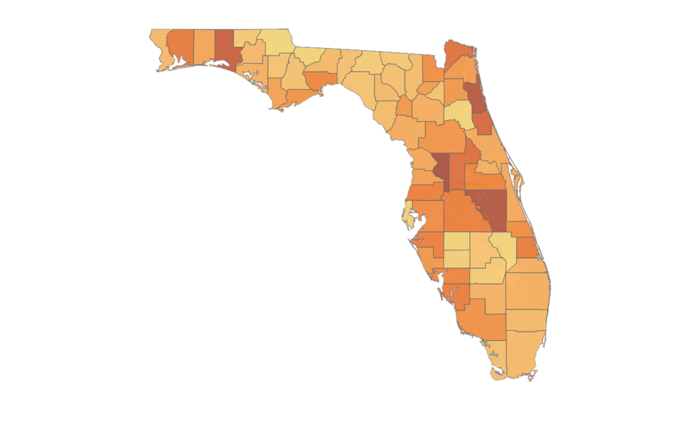
Florida’s Demographics
Are Changing
Florida’s Next
2.9 Million People
Top Projected Increases
Miami-Dade 368K
Orange 330K
Hillsborough 317K
Broward 261K
Palm Beach 231K
Duval 196K
Lee 192K
Polk 182K
Osceola 151K
Pasco 137K
16. Pinellas 90K
Top Growth Rates
Sumter 31.1%
Osceola 29.7%
St. Johns 29.1%
Walton 26.6%
Flagler 24.3%
Lake 23.0%
Nassau 22.3%
Santa Rosa 20.8%
St. Lucie 20.6%
Lee 20.2%
Top 5: 52.5%
Top 10: 82.4%
Notes:
544K across 3 counties

Slide 8
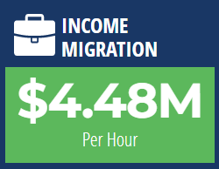
Florida Leads the Nation in Net Income Migration
#1 in the United States
Previously
Current
$39.2 Billion
2020-2021
Florida has a Net Income Migration from 48 of 50 States:
Competitors’ Current
Income Migration Per Hour:
California: -$3.32M
New York: -$2.80M
Illinois: -$1.24M
Texas: $1.25M
Top 5 Net Gained Wealth From:
New York ($9.8 Billion)
Illinois ($3.9 Billion)
New Jersey ($3.8 Billion)
California ($3.5 Billion)
Pennsylvania ($1.9 Billion)
Net Lost Wealth To:
Tennessee (-$4.9 Million)
Wyoming (-$104.9 Million)
Tampa Bay: $2.8B Annual, $320K/Hour
www.TheFloridaScorecard.org
Notes:
Income Migration – Annual, Next Release Unknown (not soon)
Top FL Counties: Miami-Dade 7.4B, Palm Beach 7.2B, Collier 4B, Lee 24.B.
Pinellas #7
Hills #9
Pasco #18

Slide 9
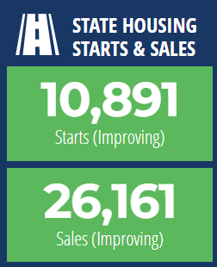
Housing Market Continues to Cool… Yet Prices Remain High
Starts: Mar ’23
Sales: Mar ‘23
17.9%
from Mar ‘22
Starts:
15.0%
from Mar ‘22
Sales:
Median Sale Price: $405,000 (+2.1% from March 2022)
Notes:
Hillsborough: -18.8%, 410K +2.5%
Pasco: -12.2%, 370K +0.0%
Pinellas: -9.9%, 445K +2.3%

Slide 10
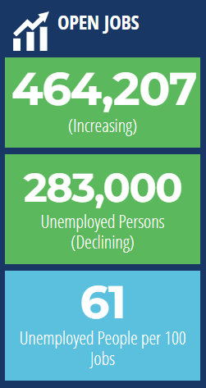
For Every 100 Open Jobs, 61 Floridians are Looking for Work
Hillsborough: 48
Pasco: 107
Pinellas: 52
Region: 55
61 Unemployed Floridians
for Every 100 Open Jobs
Notes:
Open Jobs – Unknown release date, latest would be 5/19
Unemployed Persons – Monthly, 5/19
*the ratio changes when either of these numbers change. The numbers are released at different times, so the ratio changes twice a month.

Slide 11
Florida’s Employment Continues to Rise
9,691,600
March 2023 Employment
March ’22 – March ‘23
Job Change
Feb ’23 – March ‘23 Job Change
+413,000
+13,600
(+4.5%)
(+0.1%)
MSA: + 73,300, +5.0%
MSA: + 5,200, +0.3%
Notes:
Employment - Monthly, 5/19

Slide 12
Florida’s Growth Outpaces Larger States
FL Growth is Greatest Among Largest State Economies
Real GDP Growth Rank
Q4 2018 – Q4 2022
Real GDP Rank
Q4 2022
#4
#17
#12
#20
#41
14.4%
Florida
California
Texas
New York
Illinois
#4
#1
#2
#3
#5
8.8%
9.9%
7.4%
3.3%
United States: 7.7%
Notes:
GDP – Quarterly, 6/30

Slide 13
Where Are We Headed?
2023 will be another year of strong job growth – 250,000+ New Jobs in 2023 (79K CYTD)
Population growth will remain strong – approximately 350,000 new residents
Workforce availability and participation rate will continue to remain a concern – unemployment rate will continue to be below national average of 3.5% (Florida currently at 2.6%, US 3.6%)
Stronger GDP growth for Florida’s economy versus U.S. as a whole (1.9% vs. 0.9%)
Inflation will be a significant concern for consumers and businesses
Transactions of single-family homes will return to pre-pandemic levels, but without much erosion in prices (prices up 1.25% from 12/2022 level). Approximately 80,000-85,000 single family housing starts (27K CYTD) and 250K-270K (59K CYTD) single family sales.
Florida will continue to lead income migration – latest IRS data shows $39.2B in net annual income migration, #1 in nation.

