Slide 1
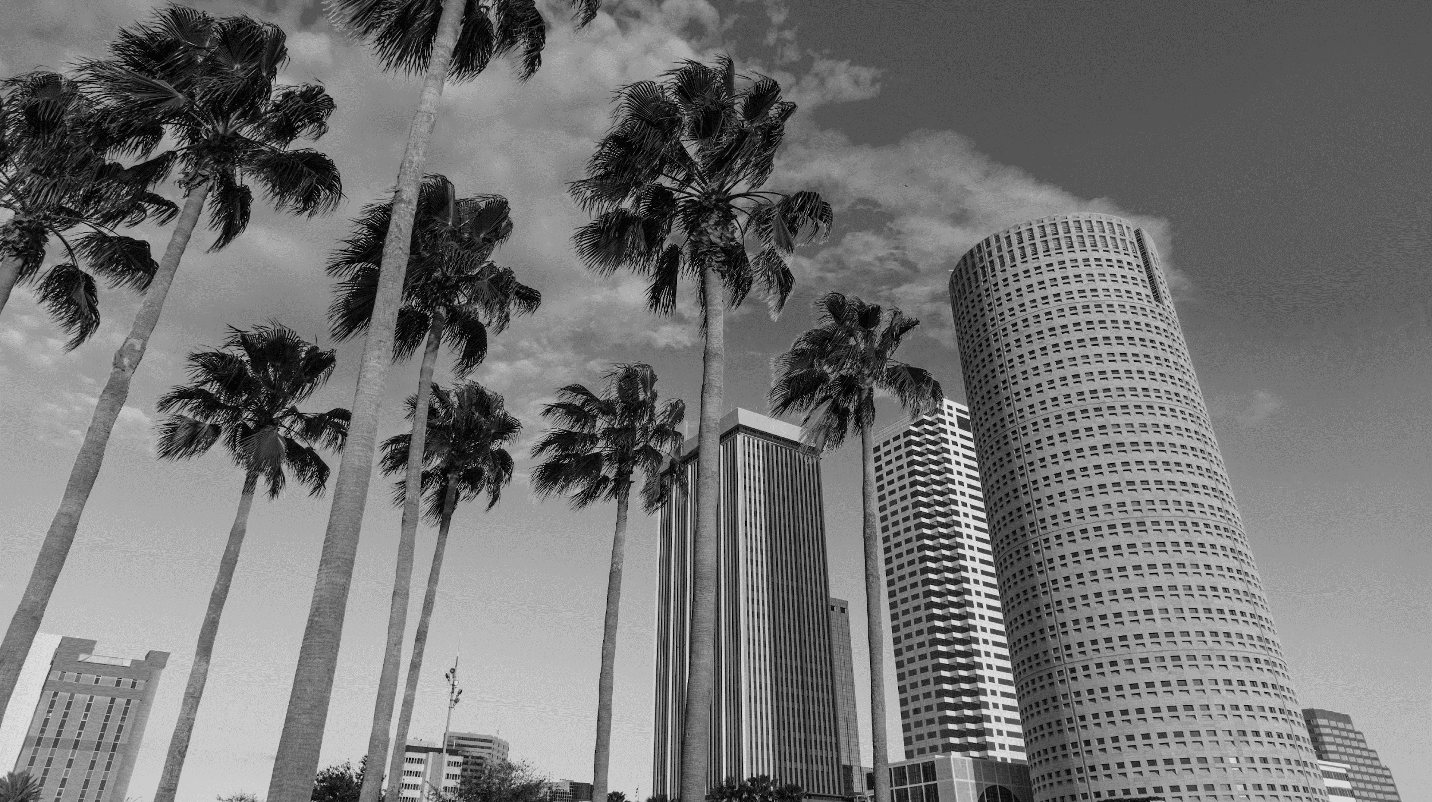

MULTIFAMILY DEVELOPMENT 2023
THE TAMPA METROPOLITAN AREA
PRESENTED BY DARRON KATTAN
FranklinSt.com

Slide 2
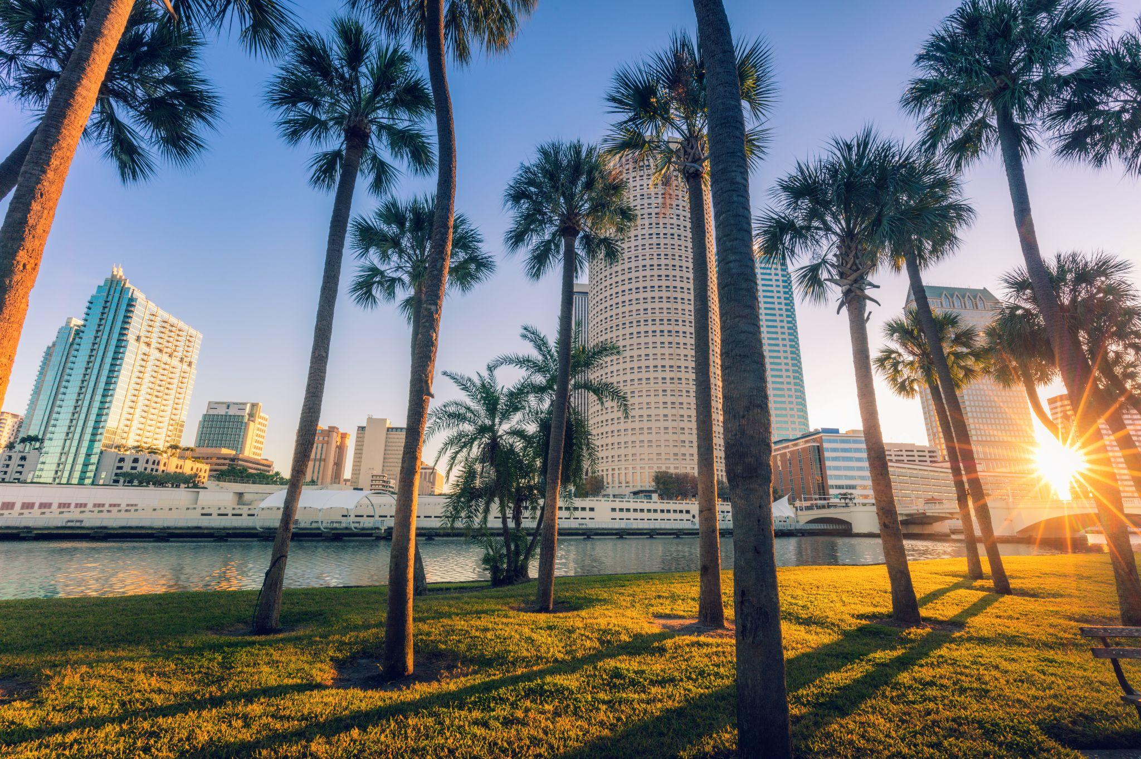
1
MARKET OVERVIEW
TAMPA MSA

Slide 3
Jacksonville
TAMPA BAY MARKET OVERVIEW
SUBMARKET CONSTRUCTION INVENTORY (EXISTING, UNDER CONSTRUCTION, PLANNED)
Orlando
Tampa
Tampa Bay MSA
DOWNTOWN TAMPA
Existing: 318,789 UNITS
Proposed & Planned: 68,167 UNITS
Under Construction: 18,865 UNITS
Completed in 2022: 8,996 UNITS
Completed in 2023: 2,752 UNITS
Existing: 9,049 UNITS
Proposed & Planned: 10,038 UNITS
Under Construction: 1,648 UNITS
Completed in 2022: 1,358 UNITS
Completed in 2023: 0 UNITS
Miami
THE WESTSHORE DISTRICT
DOWNTOWN ST. PETERSBURG
Existing: 5,800 UNITS
Proposed & Planned: 1,714 UNITS
Under Construction: 566 UNITS
Completed in 2022: 0 UNITS
Completed in 2023: 180 UNITS
Existing: 7,533 UNITS
Proposed & Planned: 7,594 UNITS
Under Construction: 819 UNITS
Completed in 2022: 90 UNITS
Completed in 2023: 577 UNITS

Slide 4
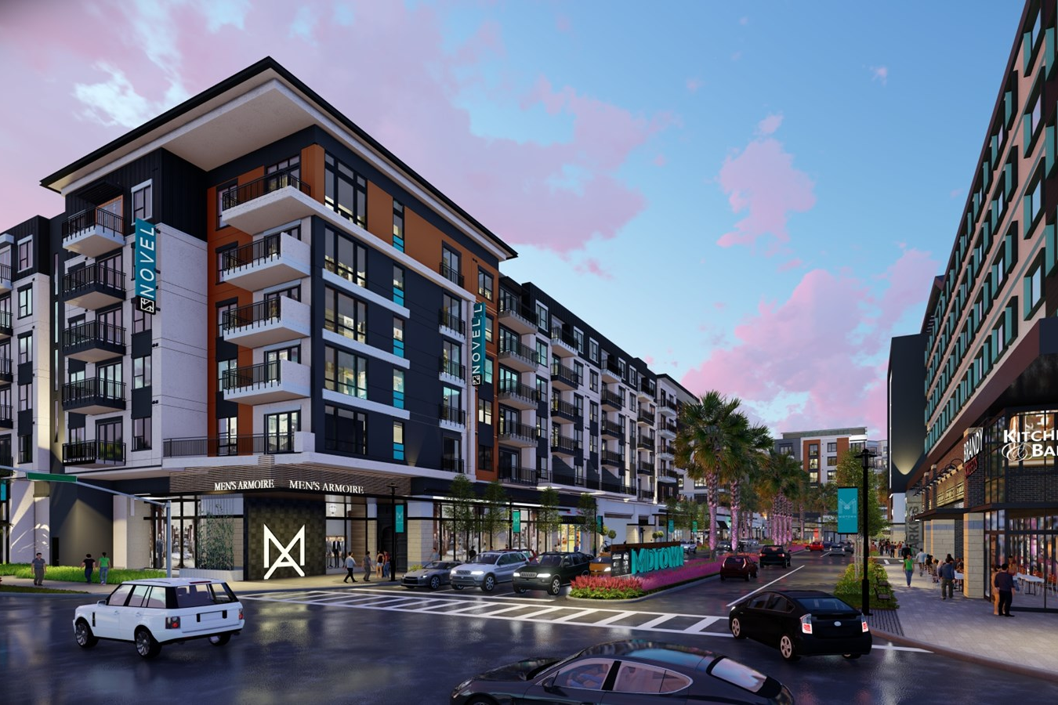
2
SUBMARKET SPOTLIGHT:
THE WESTSHORE DISTRICT

Slide 5
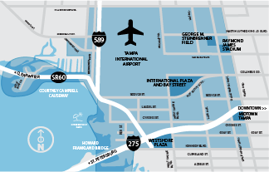









65% of People
Who Live in Westshore
Work in Westshore
FACTS & FIGURES
+
+
$1B
IN PRIVATE INVESTMENTS
4,000+
BUSINESSES
3,600
APARTMENT UNITS ADDED SINCE 2009
15,000
RESIDENTS
13.2 MILLION SF
COMMERCIAL OFFICE SPACE
250+
RESTAURANTS
100,000
EMPLOYEES
45+
HOTELS

Slide 6
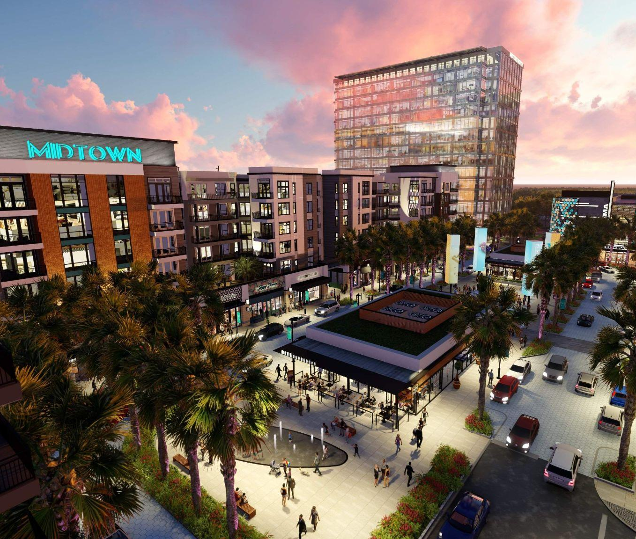
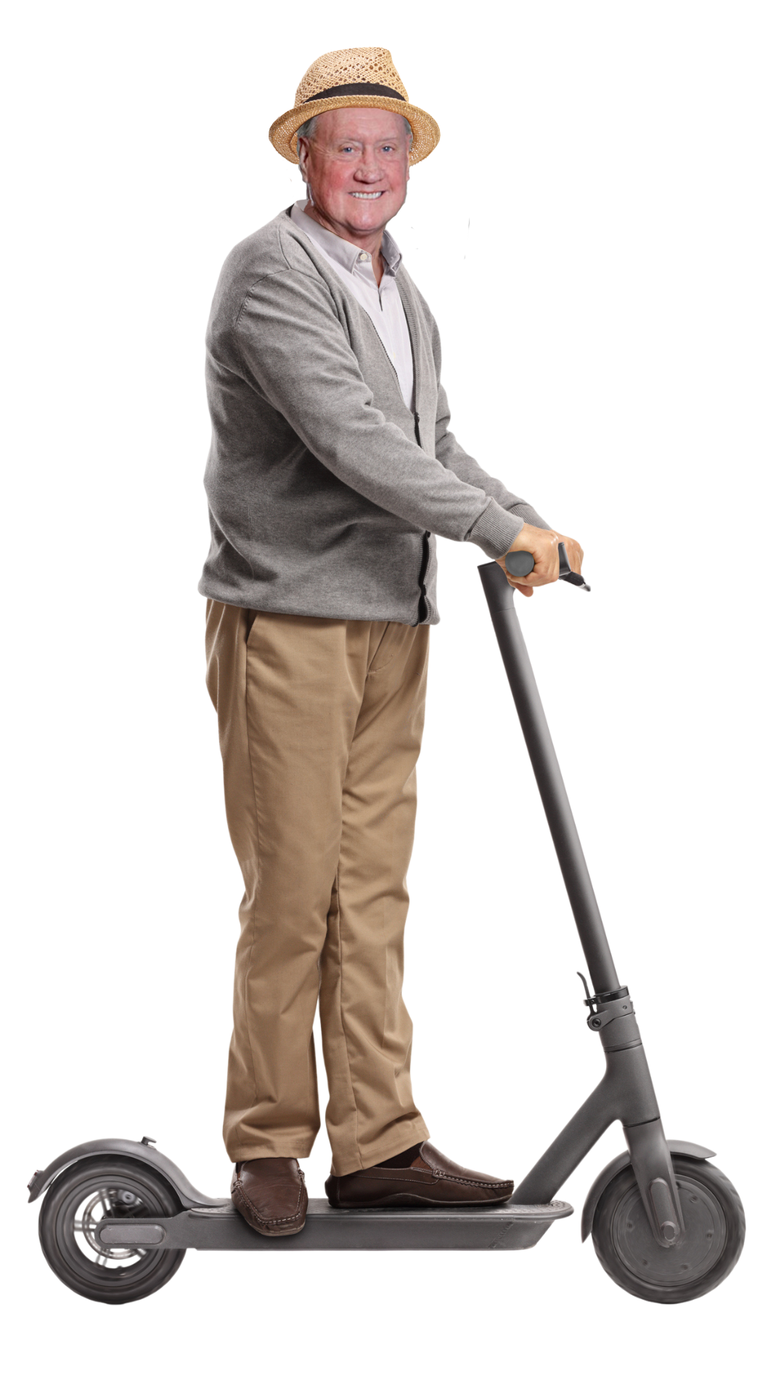
WHY WESTSHORE ?
Scooterfication
Access To Work & Play
Development Opportunity/Sites
Pro Development Mindset?
Infrastructure Benefits

Slide 7
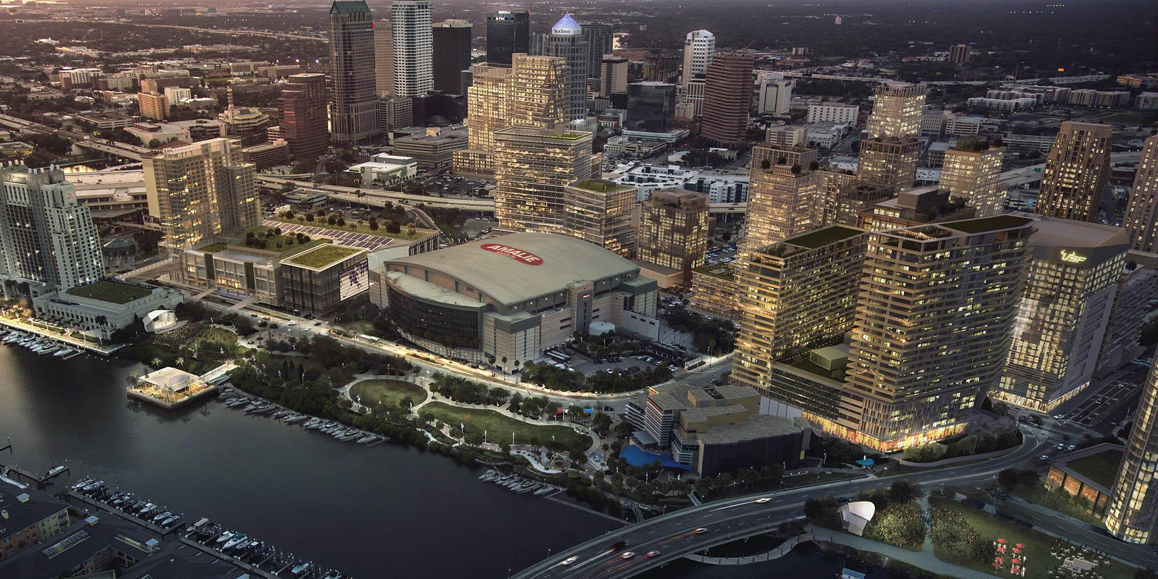
3
MULTIFAMILY DEVELOPMENTS
WESTSHORE, HILLSBOROUGH, & PINELLAS

Slide 8
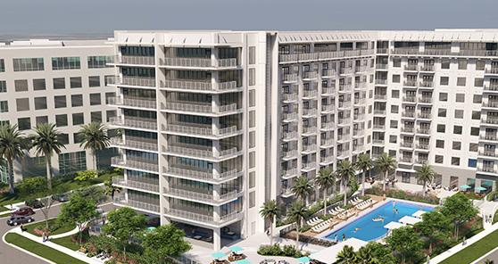
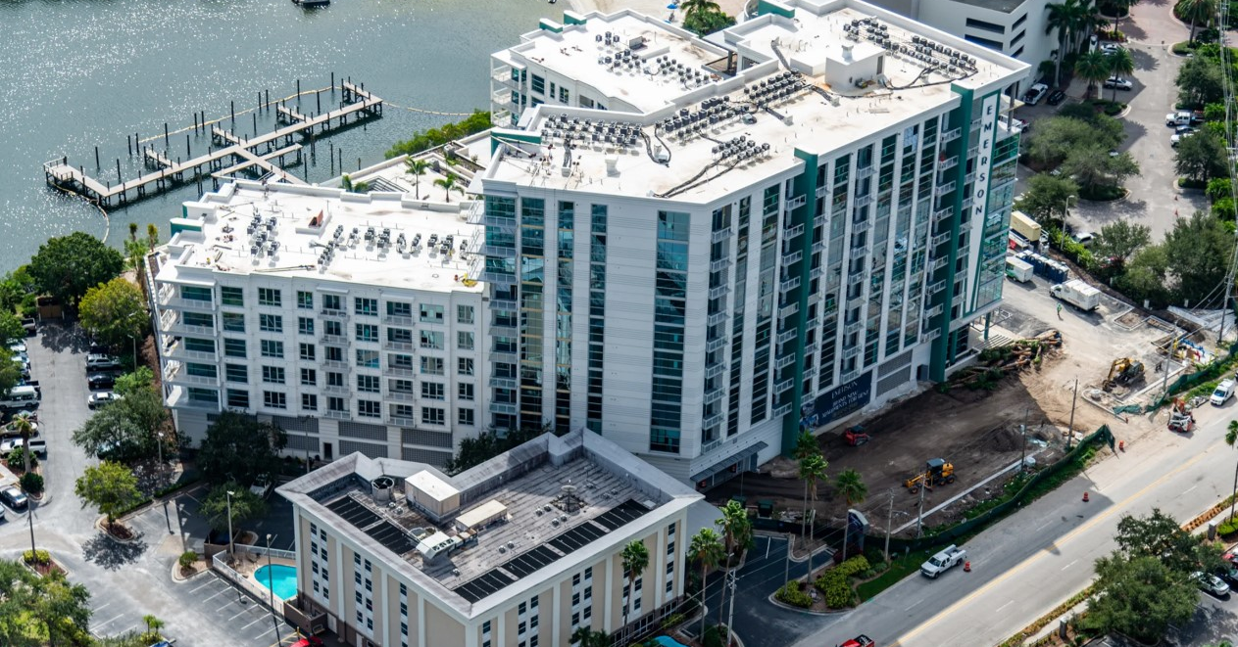
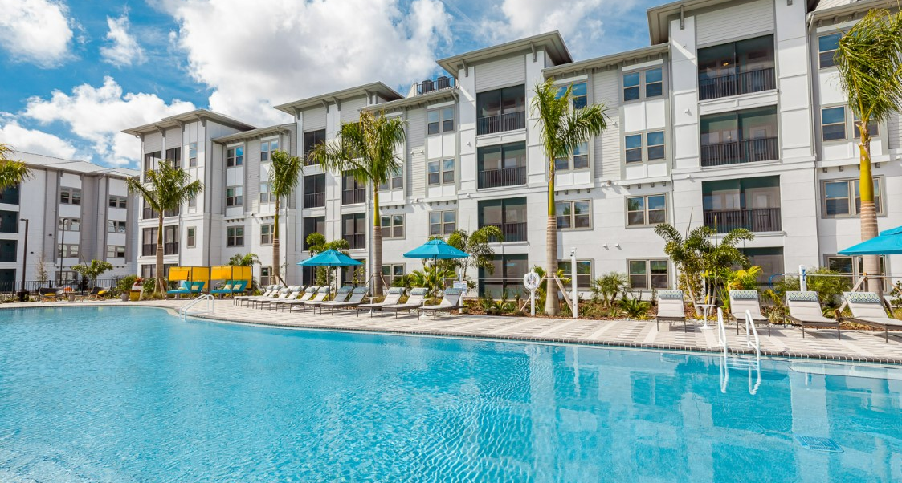
Novel Beach Park - 289 Units
Under Construction - 100+ Units
Westshore District
Novel Beach Park, 289 Units – Developer - Crescent Communities
​Novel Independence Park, 277 Multifamily Units - Developer - CP Capital & Crescent Communities
Emerson on Rocky Point - 180 Units
Total Projects: 2
Total Units: 566
Hillsborough
Casa Marti - 127 Units
Lantana at Cypress Cay - 252 Units
The Parian Luxury Apartments - 363 Units
Causeway Commons - 289 Units
Zimmer Apartments - 225 Units
5701 Bayshore Blvd - 129 Units
15081 Cypress Cay Blvd - 198 Units
Prose Sabal Park - 336 Units
Parian Luxury Apartments - 363 Units

Slide 9
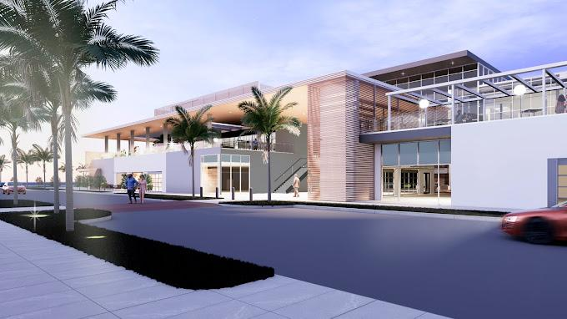
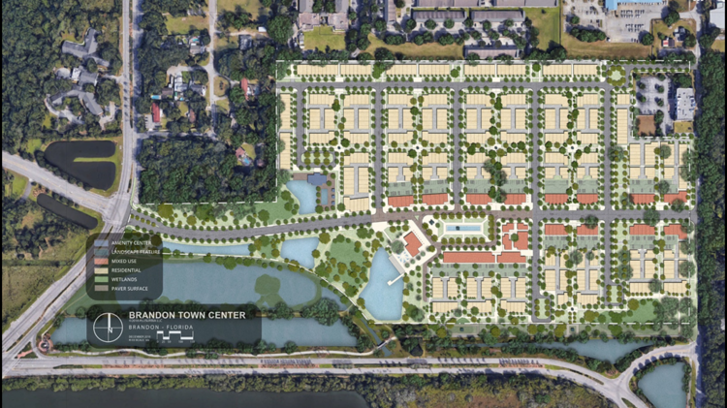
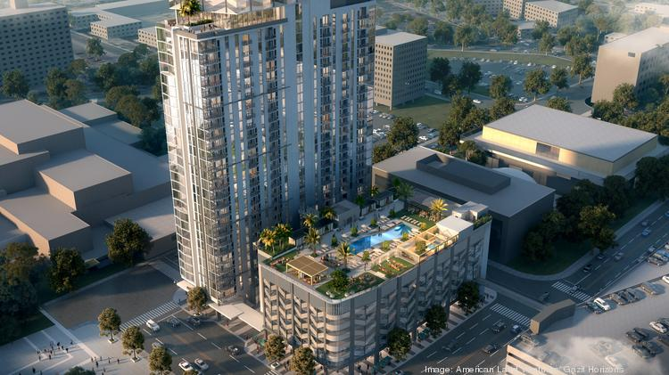
Rithm at Uptown - 1,627 Units
Under Construction - 100+ Units
Hillsborough
Rithm At Uptown - 1,627 Units
Gas Worx - MF Phase 1 - 317 Units
Fulham Terrace - 116 Units
101 N. Meridian - 330 Units
Tampa Heights Apartments - 321 Units
The Yard at Waterset - 236 Units
Madison Palms - 317 Units
Douglas Grand at Telecom Parkway - 331 Units
Manor West River - 360 Units
Brandon Town Center - 660 Units
Rise Sereno - 320 Units
Parc Madison - 351 Units
AER Tower - 344 Units
5105 W Tyson Ave - 325 Units
404 E Zack St - 306 Units
Tapestry at Big Bend - 343 Units
Brandon Town Center - 660 Units
AER Tower - 344 Units
Total Projects: 24
Total Units: 8,523

Slide 10
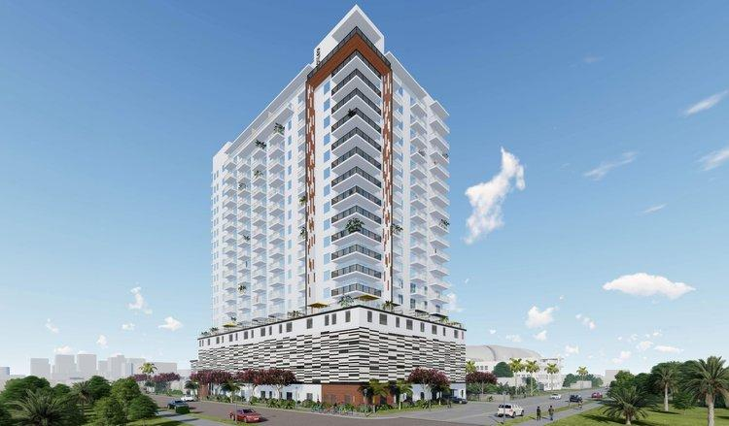
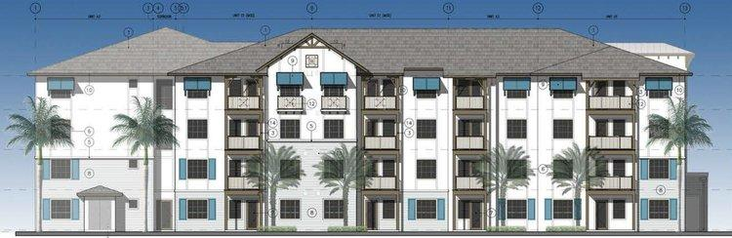
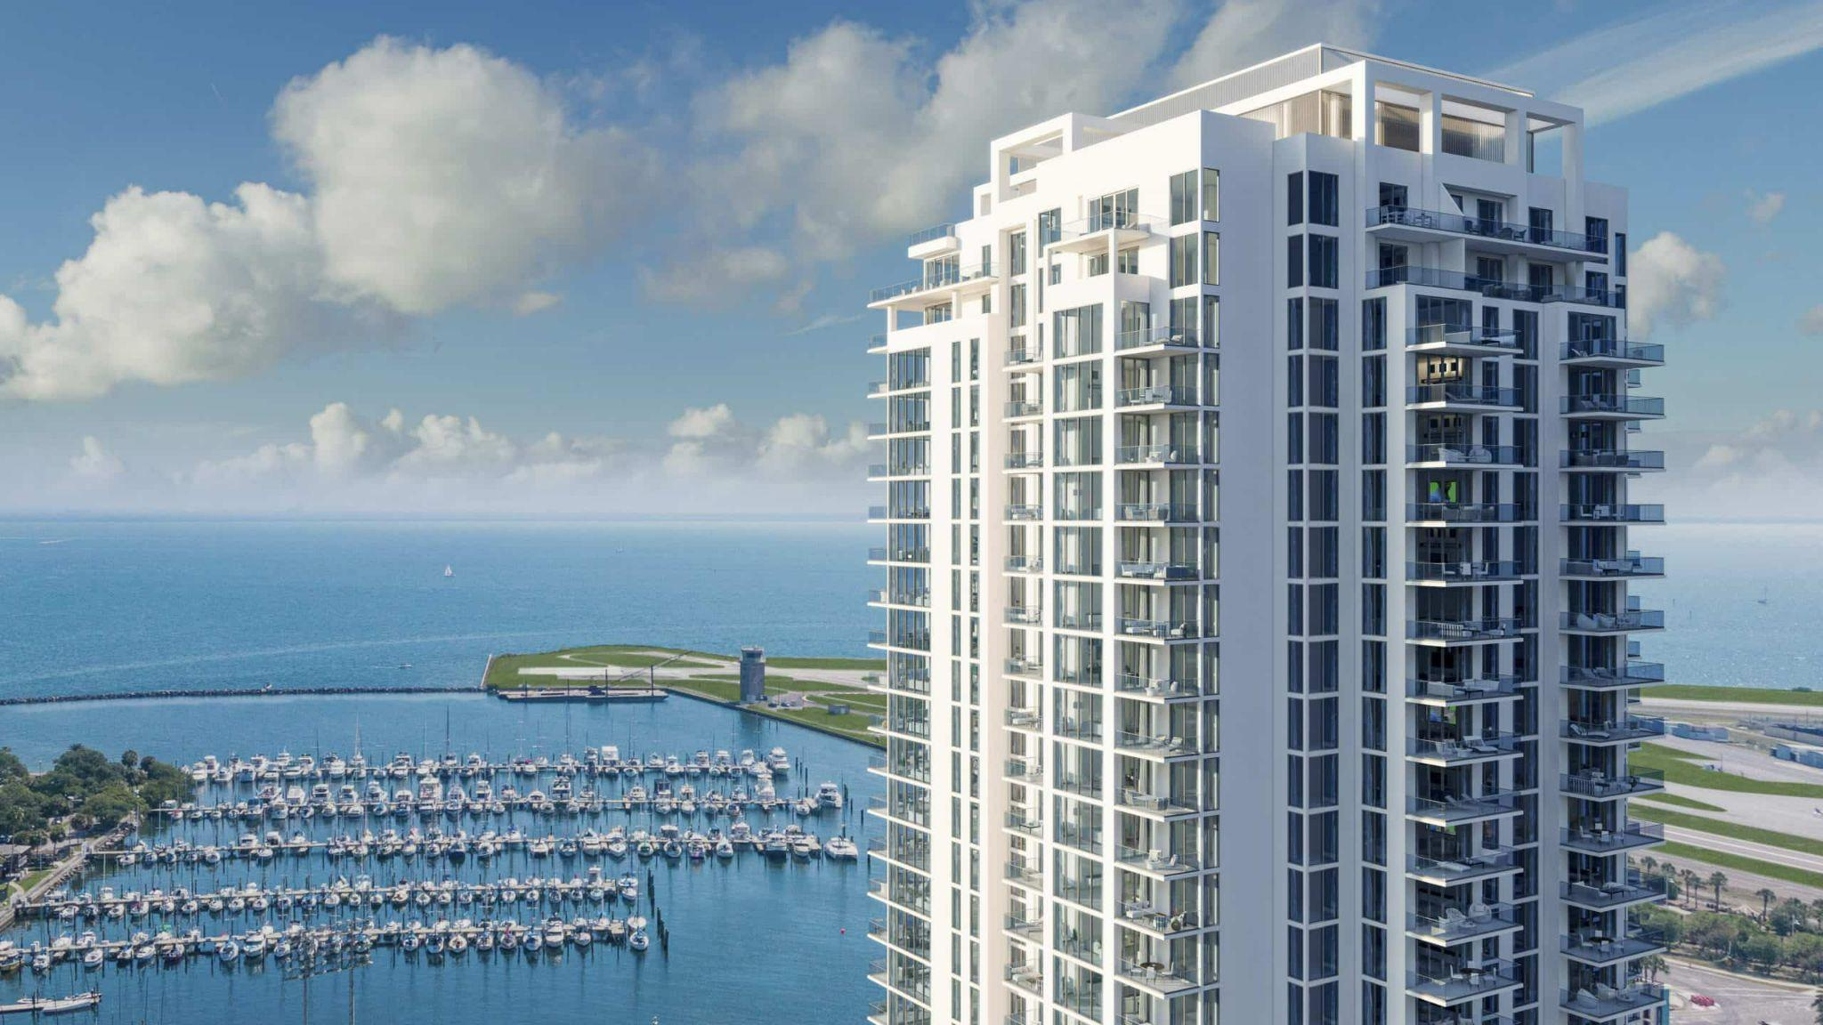
Sky St. Pete - 232 Units
Under Construction - 100+ Units
Pinellas
Modera St. Petersburg - 383 Units
Trails Edge - 204 Units
Sky St. Pete - 232 Units
Sixty90 - 204 Units
Gateway at Gandy - 415 Units
Aventon Lana - 396 Units
Linz Bayview - 398 Units
Bainbridge Bayview - 283 Units
Site9 - 174 Units
Arya - 415 Units
Lake Maggiore Apartments - 330 Units
Marina Club - 400 Units
Revel Largo Apartments - 184 Units
Gateway at Gandy - 415 Units
Sixty90 - 204 Units
Total Projects: 13
Total Units: 4,018

Slide 11
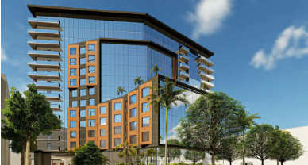
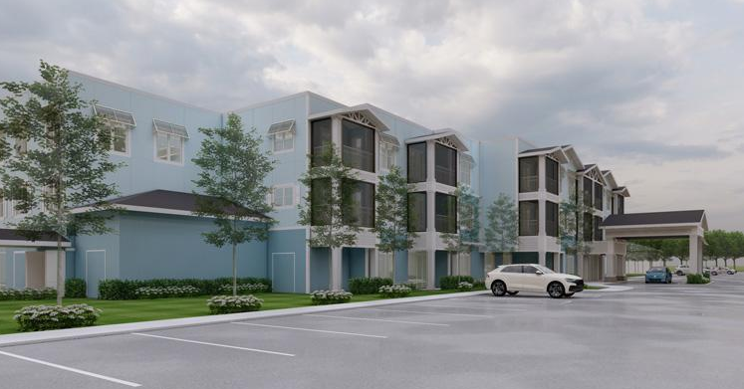
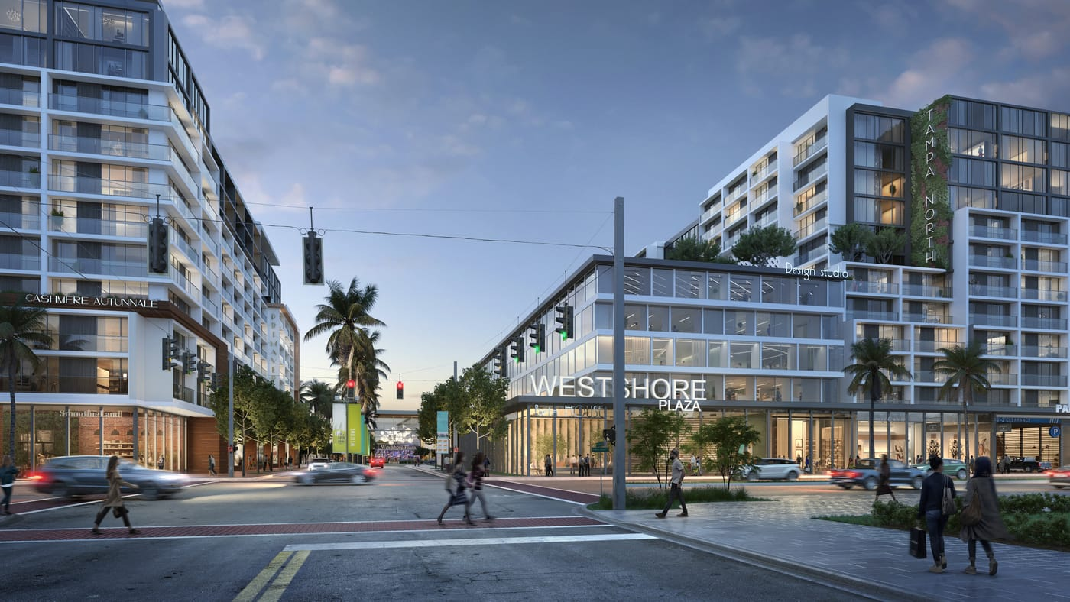
1515 Westshore - 346 Units
Proposed & Planned - 100+ Units
Westshore District ​
Residential at MetWest International, 424 Units –MetLife Real Estate Investors​​
1515 Westshore, 360 Multifamily Units / 7000 SF Retail/Restaurant​
Westshore Plaza Redevelopment, 895K SF Retail, 200K SF Office, 120K SF Medical Office, 350 Multifamily Units, 240 Hotel Rooms –Washington Prime Group​
Alexan Westshore, 388 Units - Ramada Hotel Redevelopment
Watermark Eleven, 192 Units
The Gallery at South Tampa - 119 Units
Total Projects: 5
Total Units: 1,714
Hillsborough ​
1101 E Harrison St - 369 Units
319 Bayshore Blvd - 130 Units
The Gallery at South Tampa - 119 Units
2117 W Kennedy Blvd - 224 Units
102 S Parker St - 1,079 Units
Tyson Point - 799 Units
Westshore Plaza Redevelopment

Slide 12
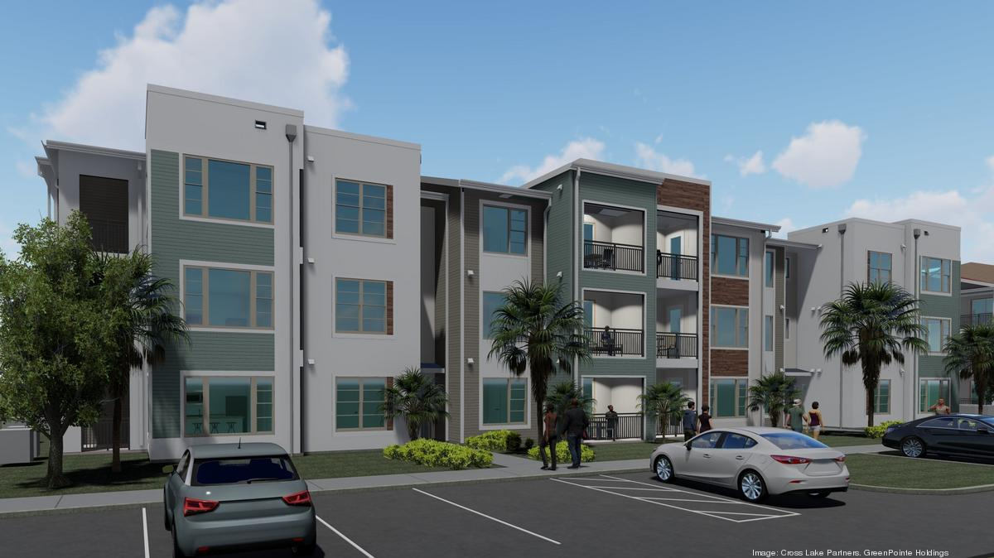
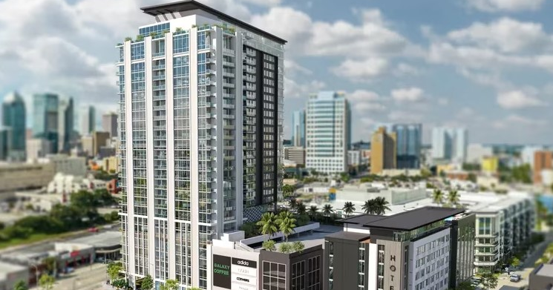
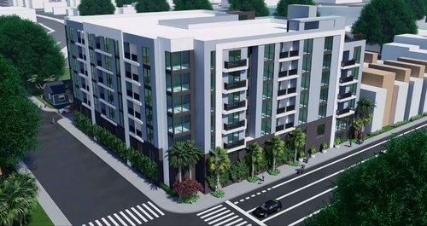
Belmont Tampa Apartments - 300 Units
Proposed & Planned - 100+ Units
Hillsborough
Belmont Tampa Apartments - 300 Units
Seasons Apartments - 487 Units
Pendry Tampa - 207 Units
Mattamy Homes Development - 205 Units
Summerall - 352 Units
Gas Worx - Apartments - 2,183 Units
623 East 7th Ave - 236 Units
Estuary Apartments - 305 Units
Pointe Grand Plant City - 252 Units
Allora Uptown - 294 Units
Encore - 213 Units
705 E Whiting St - 104 Units
Encore - 213 Units
770 Apartments - 126 Units
Total Projects: 18
Total Units: 7,858
Pinellas
442 3rd Ave - 269 Units
747 4th Ave N - 135 Units
770 Apartments - 126 Units

Slide 13
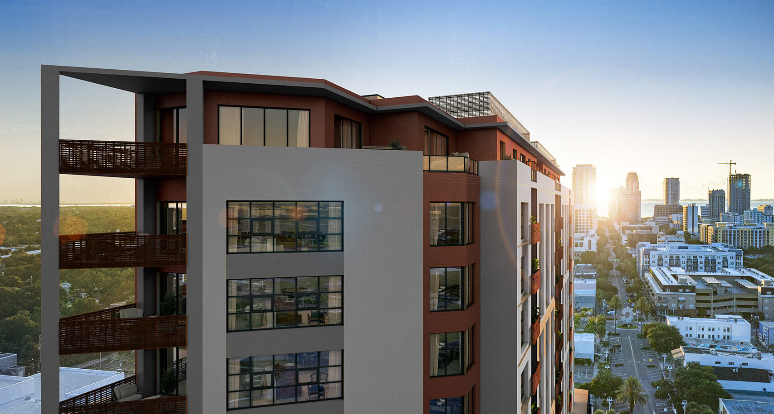
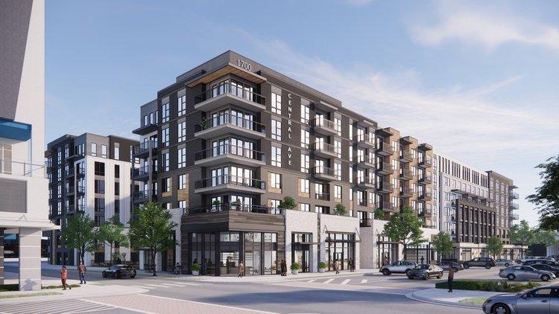
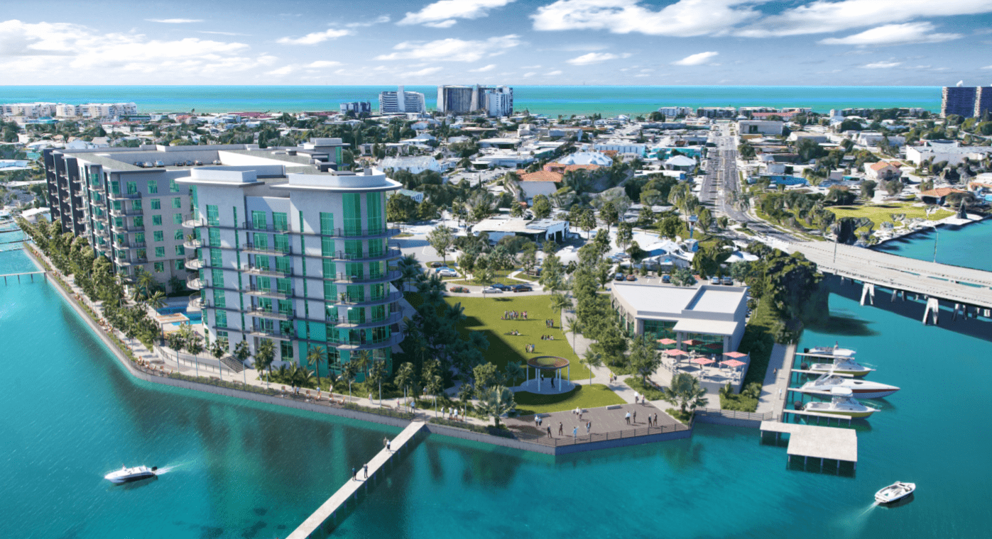
Orange State at the Edge - 103 Units
Proposed & Planned - 100+ Units
Pinellas
3235 Central Ave - 300 Units
320 Cleveland St - 400 Units
346 Tuxedo Ct S - 260 Units
Orange Station at The Edge - 103 Units
256 2nd St N - 361 Units
511 3rd Ave S - 335 Units
235 3rd St S - 268 Units
S 10th St - 5,700 Units
Marina Club Apartments - 400 Units
The Manhattan - 243 Units
Alexan 1700 - 267 Units
Corey Landing - 243 Units
Alexan 1700 - 267 Units
Corey Landing - 243 Units
Total Projects: 15
Total Units: 9,410

Slide 14
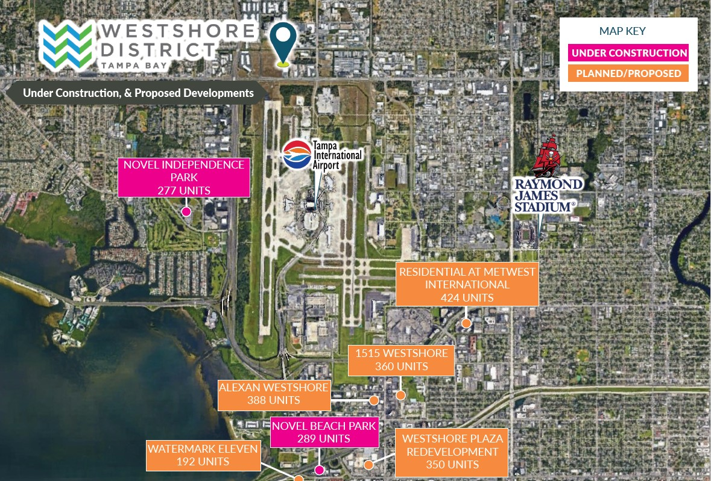

Slide 15
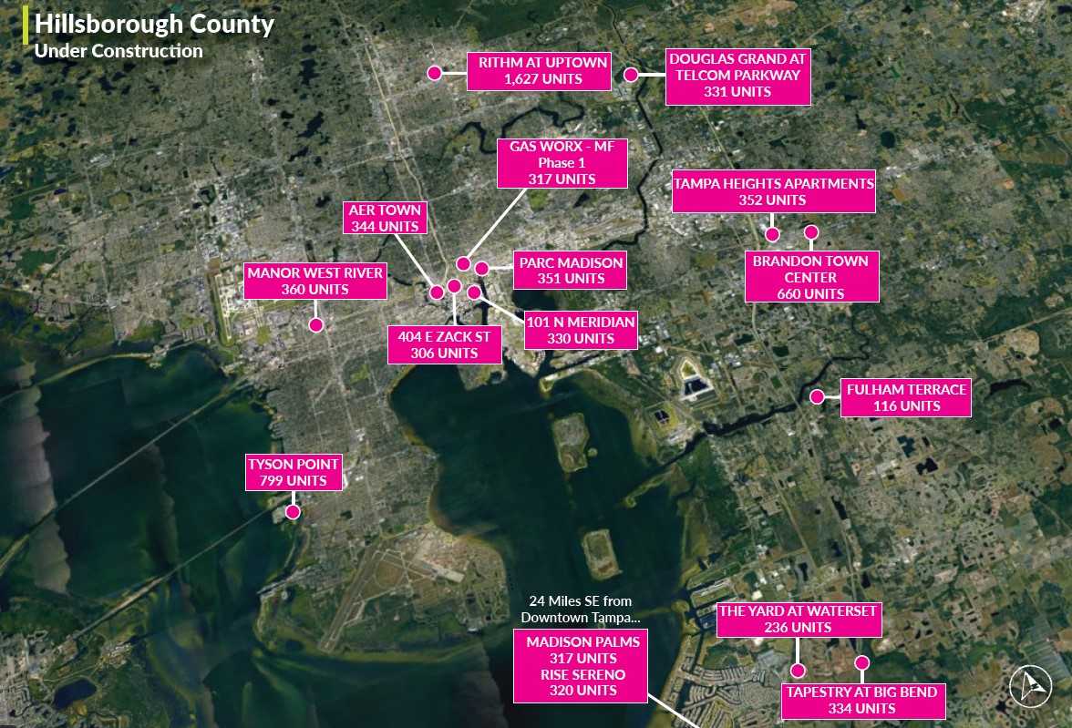

Slide 16
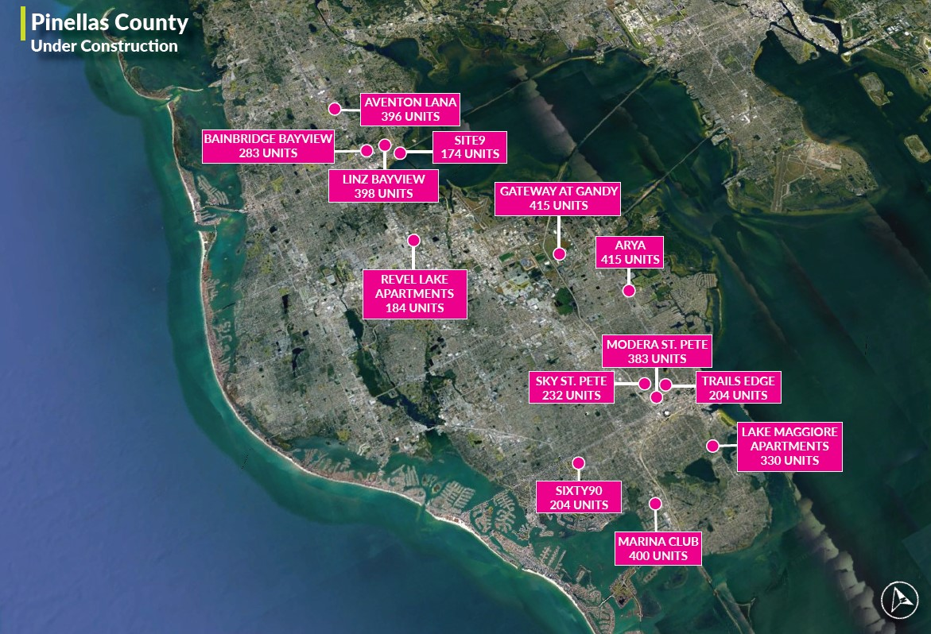

Slide 17
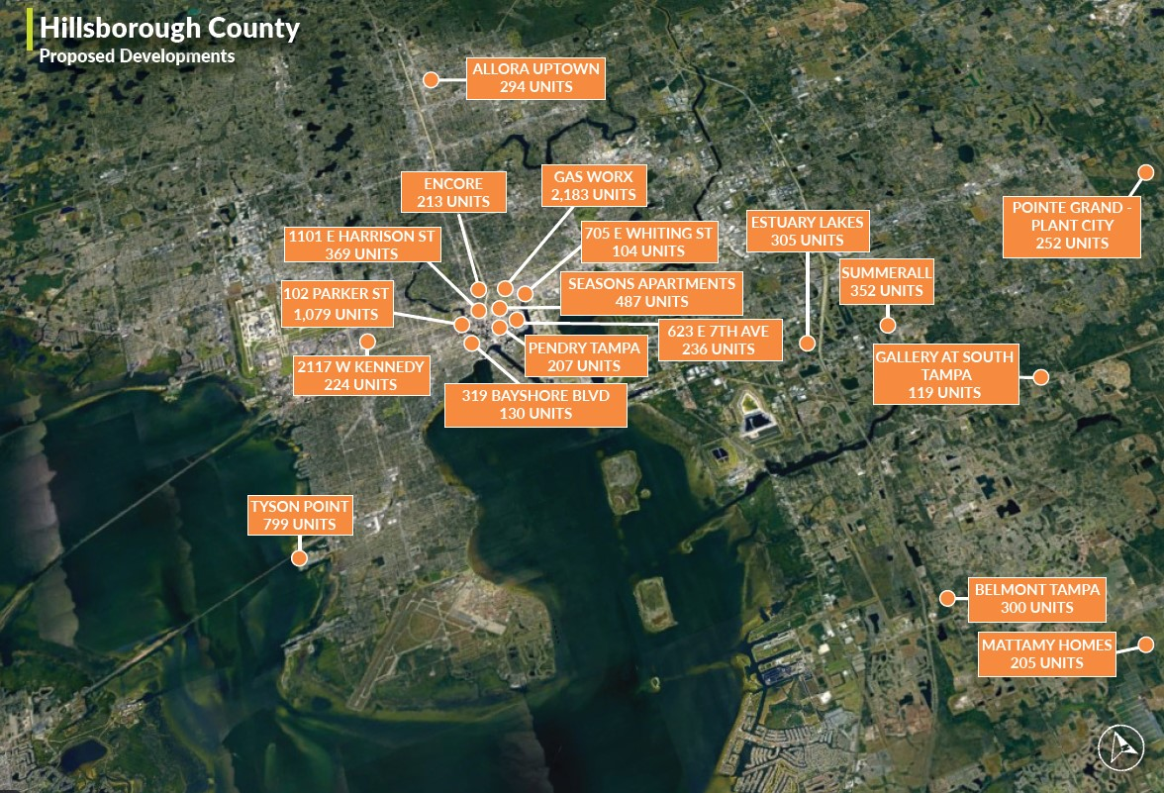

Slide 18
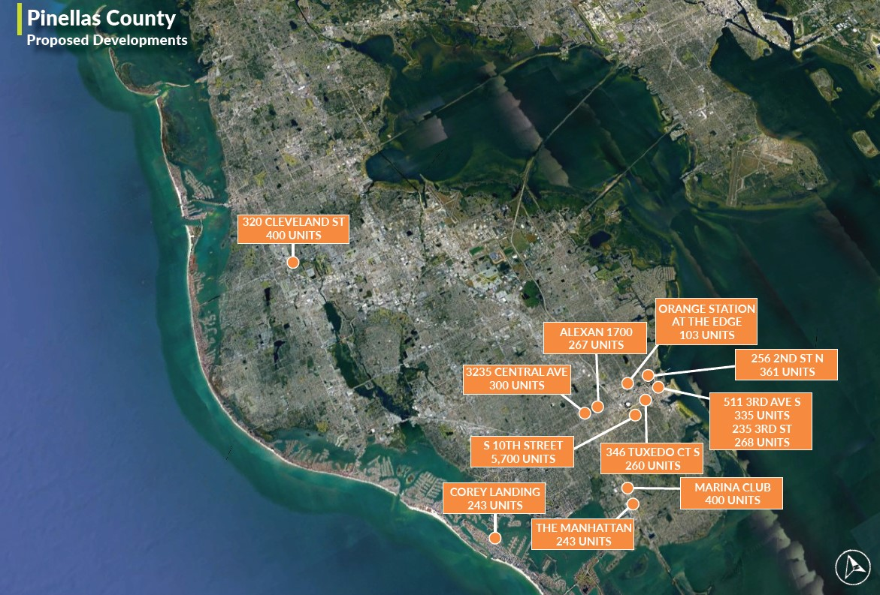

Slide 19
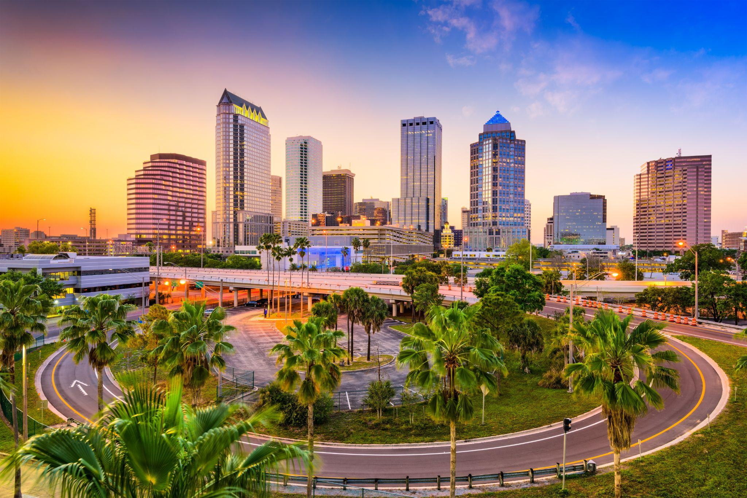
4
Transaction Velocity

Slide 20
2023 has the
Slowest Sales Transactions in
14 years
Hillsborough Transactions - 100+ Units
2020
2021
Sales Volume: $1.4 Billion
Number of Sales: 31
Average Price Per Unit: $151,704
Sales Volume: $3.7 Billion
Number of Sales: 78
Average Price Per Unit: $214,014
2023 Multifamily Investment Volumes fell 74% Compared to the Same Period in 2022
2022
Year to Date
Sales Volume: $3.1 Billion
Number of Sales: 45
Average Price Per Unit: $255,599
Sales Volume: $97.2 Million
Number of Sales: 5
Average Price Per Unit: $143,994

Slide 21
Costar reported that its Value-Weighed Index of Multifamily Property Prices Fell 7% Year-over-Year in February 2023
Pinellas Transactions - 100+ Units
2020
2021
Sales Volume: $1.2 Billion
Number of Sales: 32
Average Price Per Unit: $160,597
Sales Volume: $2 Billion
Number of Sales: 35
Average Price Per Unit: $203,831
2022
Year to Date
Sales Volume: $739 Million
Number of Sales: 12
Average Price Per Unit: $163,878
Sales Volume: $120 Million
Number of Sales: 2
Average Price Per Unit: $291,951

Slide 22
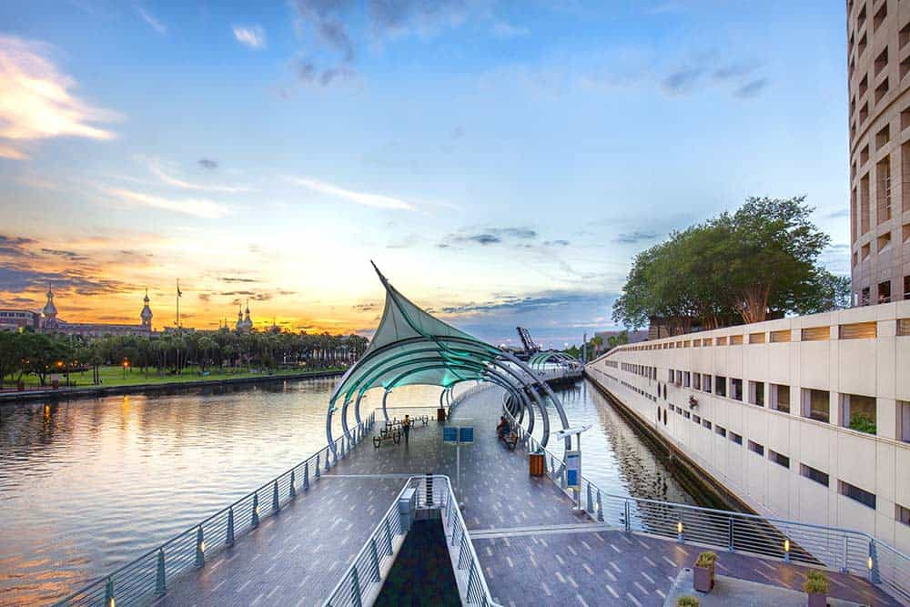
5
FUTURE TRENDS & OUTLOOK

Slide 23
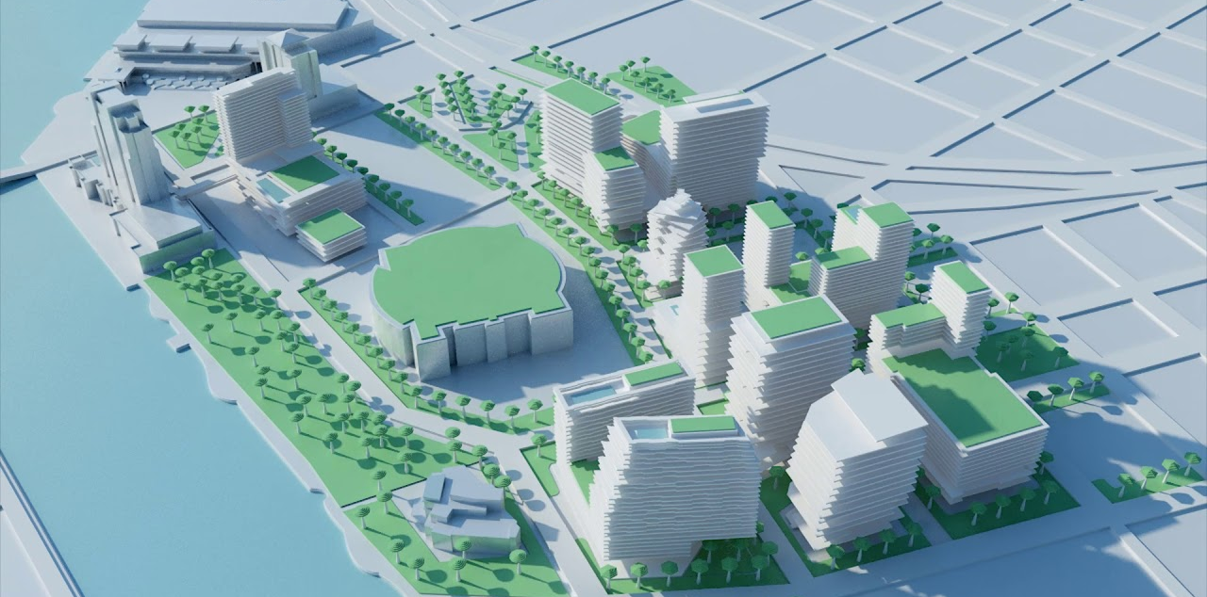
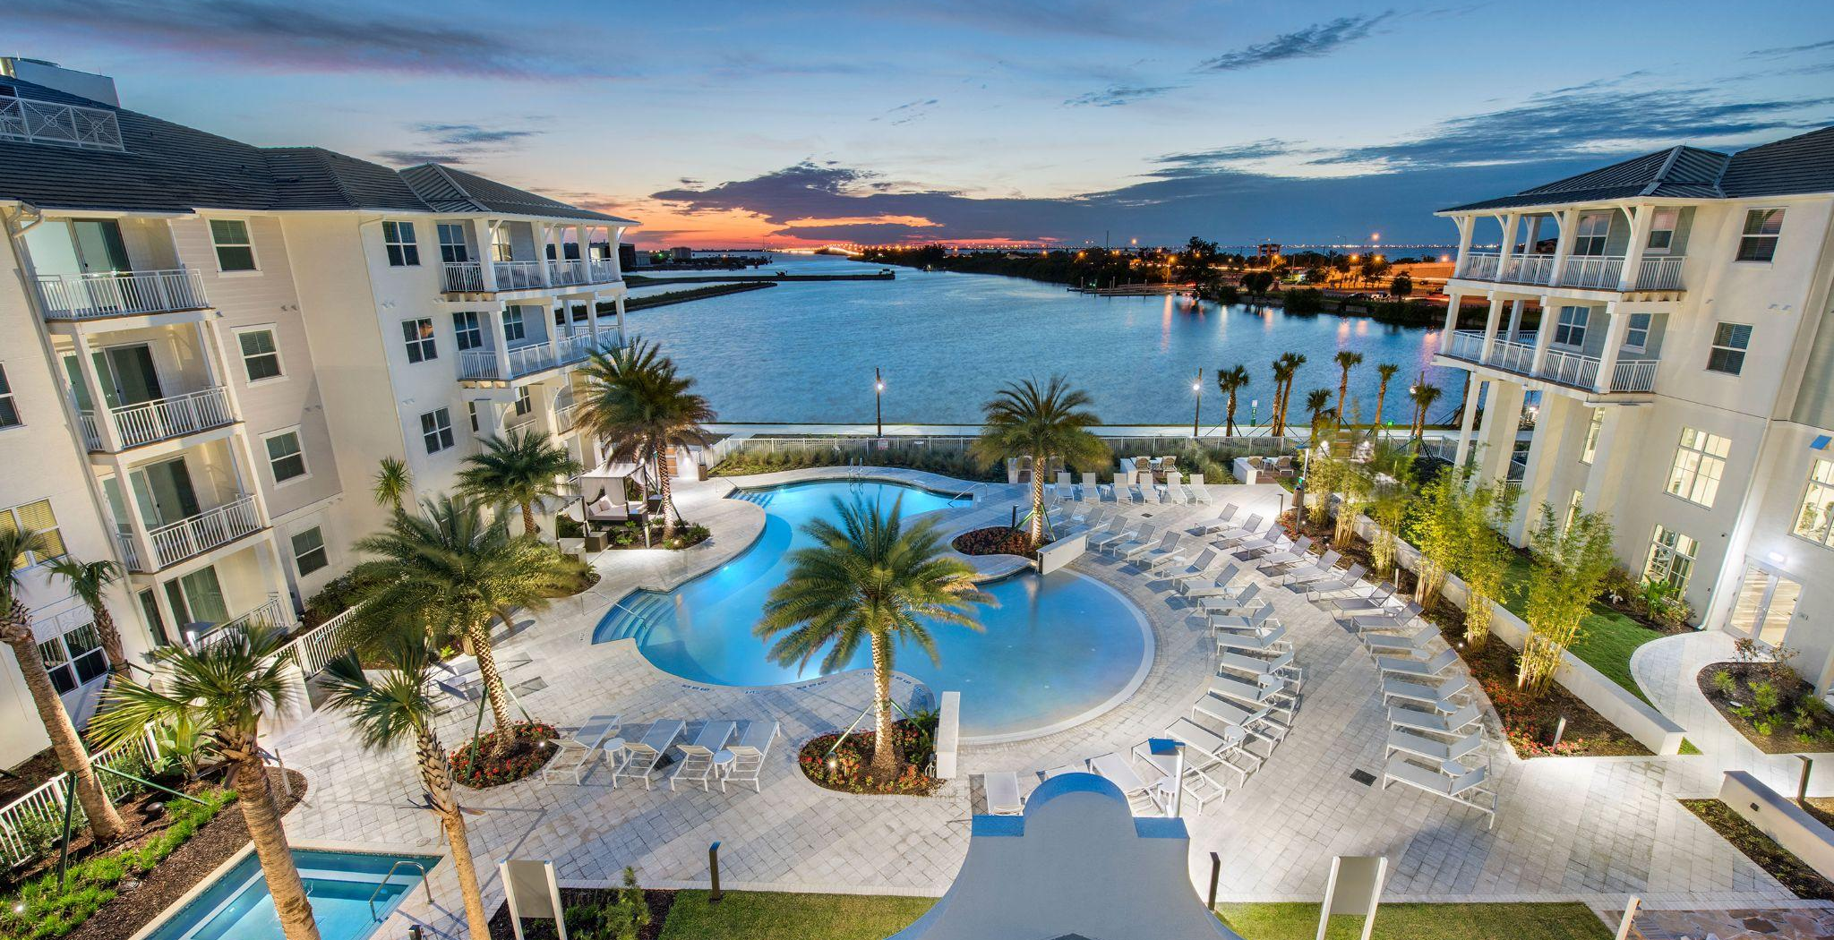
TAMPA MSA - CONTINUED GROWTH
Tampa MSA Ranked 3rd in the Nation for Total Migration 829 People Move to Tampa Every Week
Tampa Population Expected to Grow 30% by 2040 (Tampa Hillsborough Expressway Authority)
Tampa’s Job Market Increased by 6.3% Over the Year in April 2022 & is Expected to Grow 42.7% Over the Next 10 Years
Extensive Developments & Investments in Growth Water Street Tampa ($3 Billion) & Tampa Airport ($1+ Billion)
Over 50,000 Multifamily Units Planned or Under Construction YTD
Extensive Westshore Residential Development Including The Westshore Marina District & Midtown Tampa

Slide 24
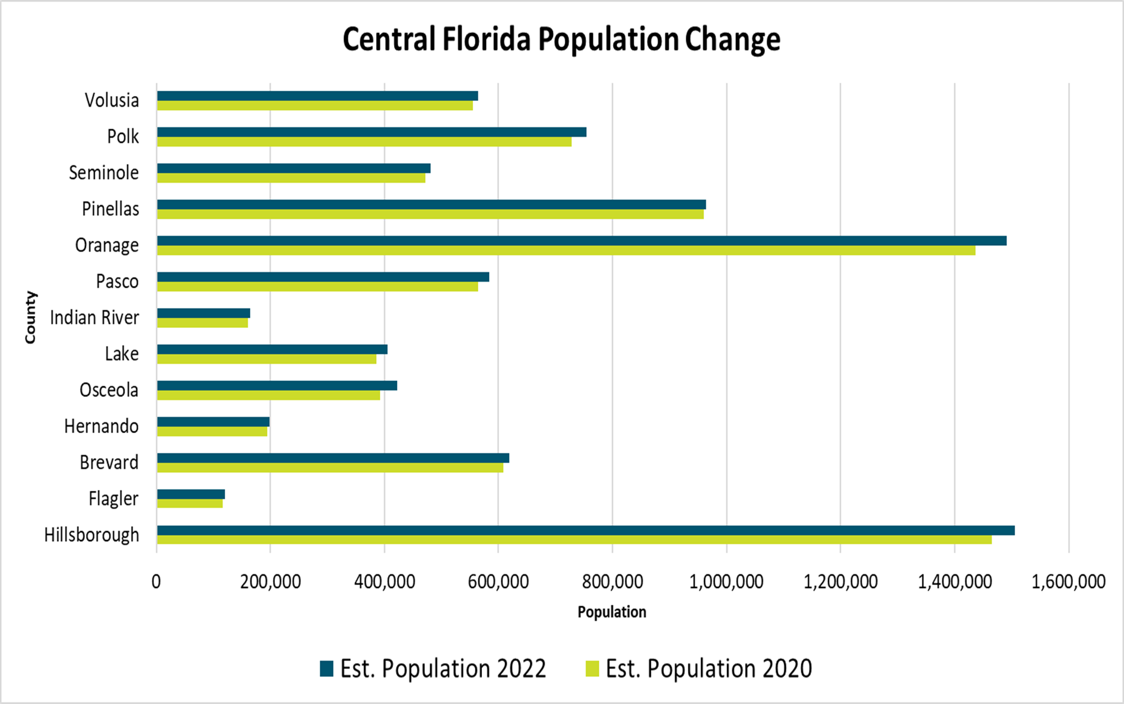
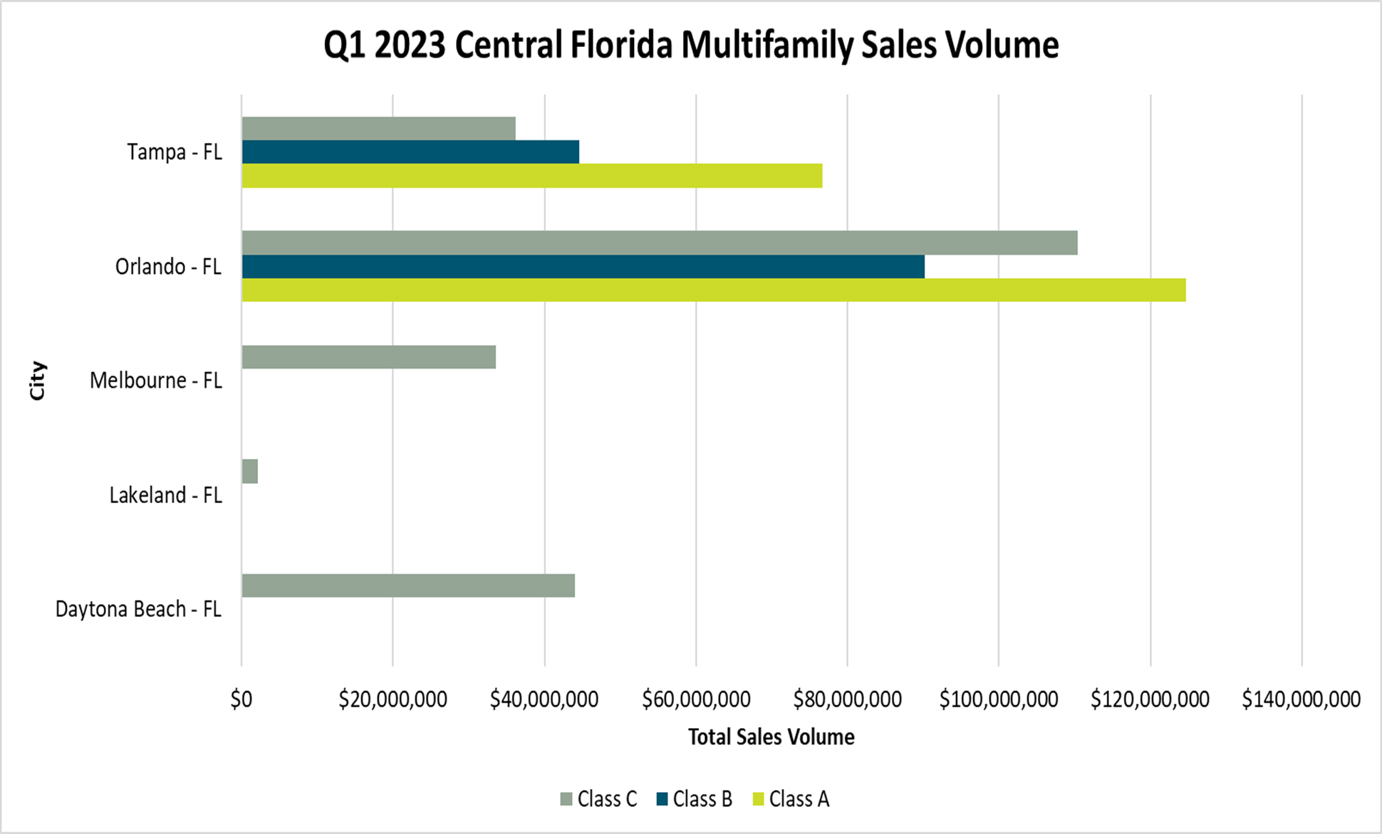
FUTURE TRENDS & OUTLOOK
POPULATION & MULTIFAMILY SALES VOLUME ANALYSIS

Slide 25
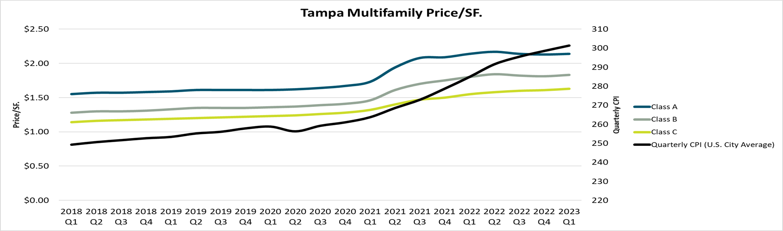
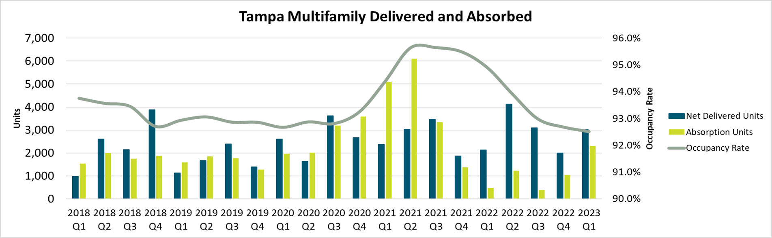
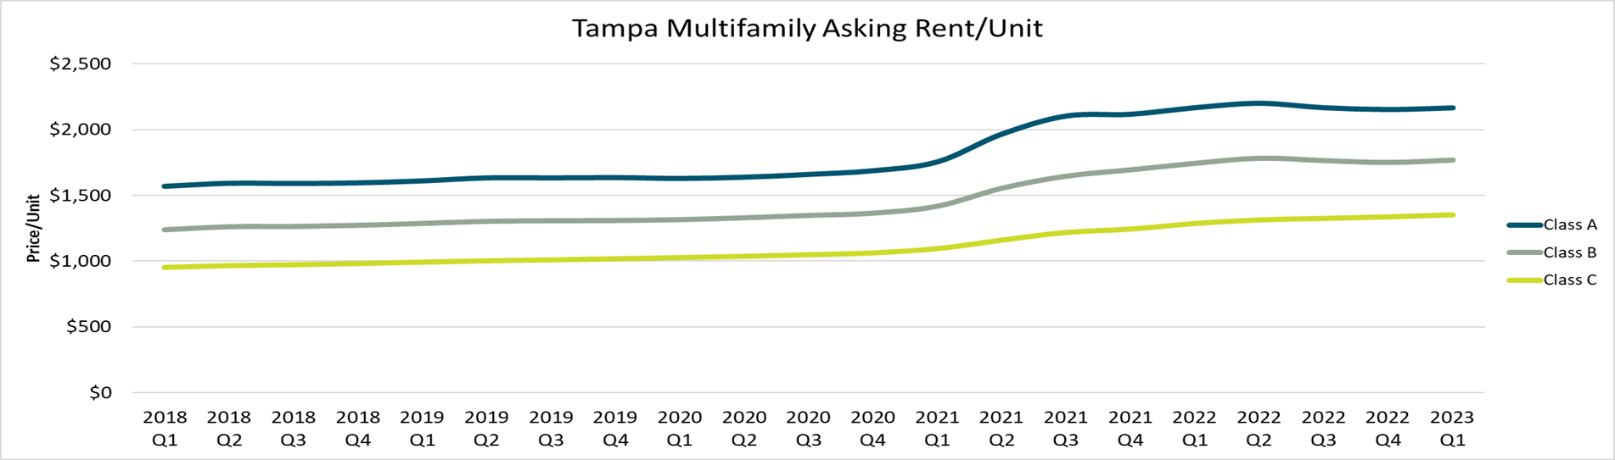
FUTURE TRENDS & OUTLOOK
TAMPA MSA - MULTIFAMILY TRENDS - Q1 2023
Tampa Experienced Rental Increases Across All 3 Asset Classes
Class A, B, & C Rents Increased by 32.84%, 34.37% & 31.49% since Q1 2020
Occupancy Rates for Tampa Multifamily Properties Averaged 92.5% in Q1 2023
2,314 Units Were Absorbed in Q1 2023 in the Tampa/St. Pete MSA
3,005 Units Were Delivered in Q1 2023 in the Tampa/St. Pete MSA

Slide 26
THANK YOU
FranklinSt.com

