Slide 1
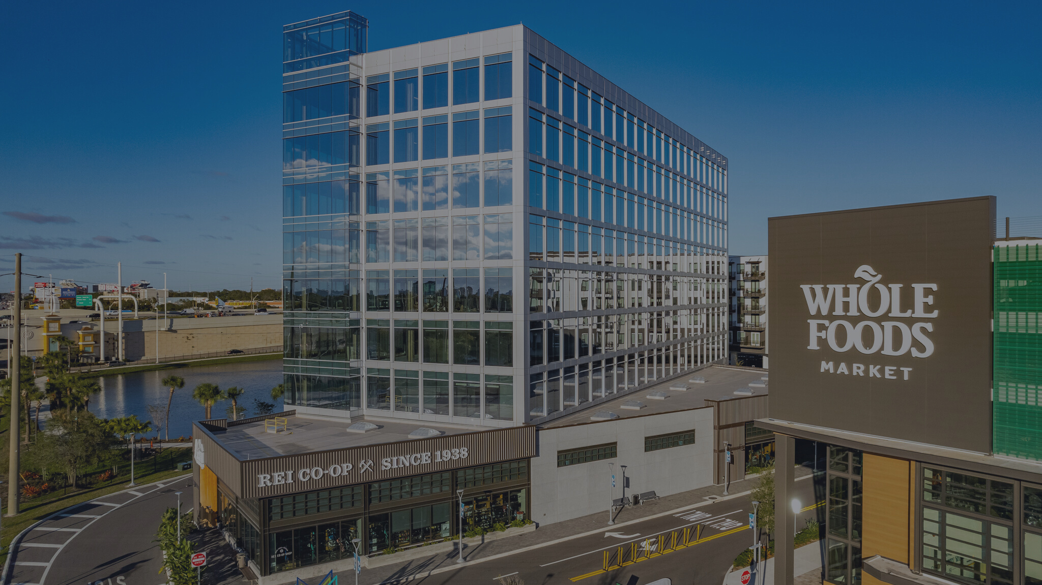
Lauren Coup
Senior Director of Leasing
Highwoods Properties
May 18, 2023
21st Annual
Westshore Development Forum
Westshore Office Market Update

Slide 2
OFFICE AT A GLANCE
TAMPA
Inventory
33.8M
Total SF
18.7M
Class A
15.4M
Class B
WESTSHORE
Inventory
13.3M
Total SF
7.9M
Class A
5.3M
Class B
Source: CBRE Q1 2023

Slide 3
WHAT'S IN THE NUMBERS?
Q1 2023
Leasing Activity
(Class A & B)
Leasing Activity
(Class A)
Vacancy Rates
(Class A)
Rental Rates
(Class A)
Tampa
859,207 SF
609,580 SF
24%
$35.35
Westshore
379,585 SF
260,482 SF
20%
$37.66
Source: CBRE Q1 2023

Slide 4
WHY CHOOSE WESTSHORE?
TAMPA
$2 Billion+
Chosen as one of the World's Greatest Places 2023 by Time Magazine
Public & private investments in Westshore with over 25 projects planned or underway
13.2M SF
Commercial office space, making up the largest suburban office submarket in Florida.
EPICENTER OF IT ALL
10 minutes to Downtown Tampa
5 minutes to TPA
30 minutes to 75% of Tampa Bay's residential neighborhoods
100K EMPLOYEES
Comprising over 4,000 businesses and major employers
26K STUDENTS
Attend classes on college campuses in Westshore, making up a large pool of talent getting ready to enter the workforce
TAMPA INT'L AIRPORT
AMENITIES
Award-winning airport with over 80 nonstop domestic and international destinations
250+ Restaurants & 350+ Retailers
45+ Hotels
Raymond James Stadium & George Steinbrenner Field
Source: Westshore Alliance Q1 2023

Slide 5
MAKING BIG MOVES
Fisher Asset
Management
Maxim
Healthcare
Services
Morgan
Stanley
(sublease)
Mad Mobile
(sublease)
Cole, Scott
& Kissane
74,724 SF
71,005 SF
53,272 SF
53,272 SF
42,400 SF
Banyan Health
Systems
(sublease)
Gale Healthcare
Solutions
(sublease)
Delta Airlines
McNichols Co.
OPSWAT
40,267 SF
39,205 SF
35,394 SF
32,075 SF
31,660 SF
Source: CBRE Q1 2023

Slide 6
NEW OWNERSHIP
FBI Building
$70,400,000 ($510/PSF)
Bridgeport Center
$40,000,000 ($222/PSF)
6550 W. Hillsborough Ave (Verizon Building)
$27,300,000 ($169/PSF)
Independence Center I
$23,000,000 ($289/PSF)
The Bridge
$14,225,200 ($145/PSF)
4401 W. Kennedy Blvd (Kennedy Building A&B)
$7,900,000 ($280/PSF)
Source: CoStar Q1 2023

Slide 7
SUBLEASE MARKET
ADDITIONS BY QUARTER
DISTRIBUTION BY SIZE RANGE
1,250,000
<2.5K SF
10
1,000,000
1.1M
40K+ SF
20
909K
750,000
2.5 to 5K SF
20
500,000
520K
354K
348K
401K
250,000
279K
326K
260K
174K
20-40K SF
21
0
Q1 2023
Q4 2022
Q3 2022
Q2 2022
Q1 2022
Q4 2021
Q3 2021
Q2 2021
Q1 2021
Q4 2020
5 to 10K SF
21
3.2M SF of sublease space available across all Tampa submarkets, making up 7.1% of total inventory
3.3% MOM net decrease in total sublease availability (175K SF was removed in March 2023)
114 subleases are available in Tampa Bay
10-20K SF
22
Source: CBRE Q1 2023

Slide 8
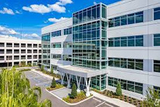
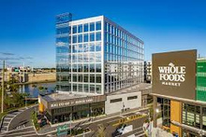
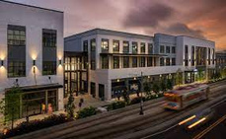
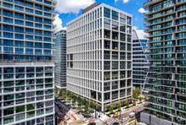
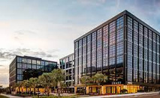
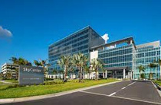
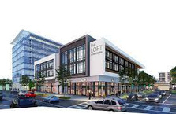
CHANGING THE SKYLINE
RENAISSANCE CTR VII
MIDTOWN WEST
115K SF 100%
152K SF 97%
SPARKMAN WHARF
1001 WATER STREET
150K SF 100%
380K 79%
HEIGHTS UNION
SKYCENTER ONE
300K SF 100%
275K SF 99%
Ask for feedback
THE LOFT AT MIDTOWN
72K SF 100%
COMPLETED 2020
COMPLETED 2021
Source: CoStar Q1 2023

Slide 9
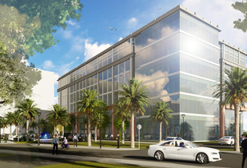
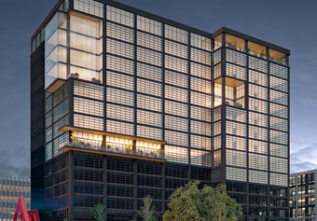
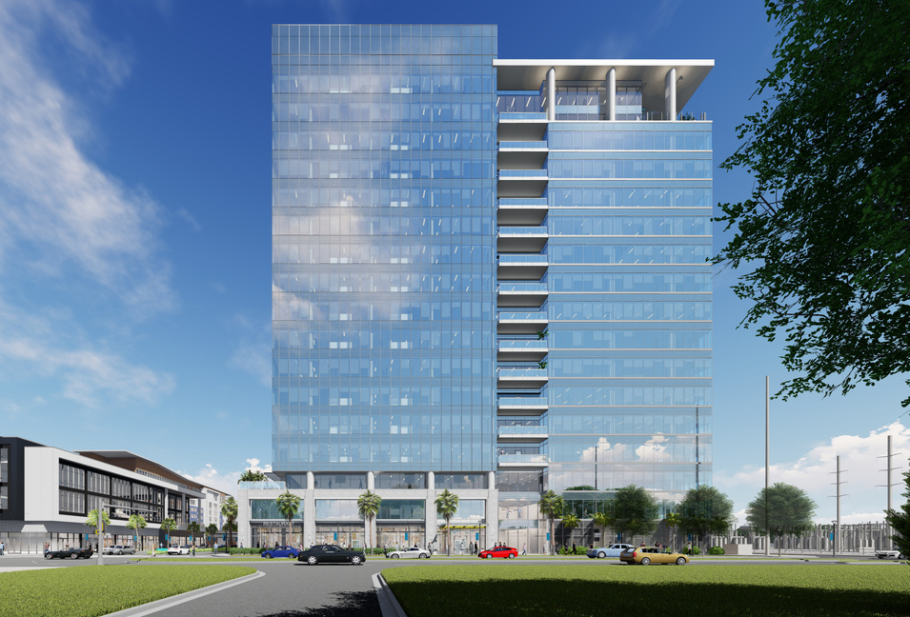
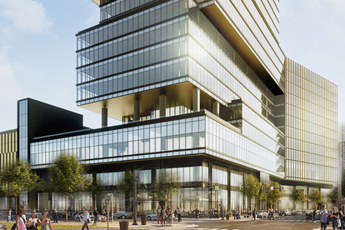
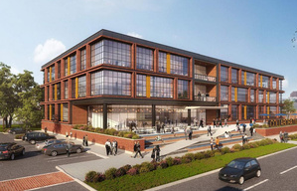
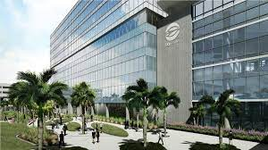
THE FUTURE OF NEW CONSTRUCTION
MIDTOWN EAST
Corporate Center V
Heights 201
180K SF
286K SF
400 Channelside
500K SF
Collaborative Werx
430K SF
Est. Q1 2025
120K SF
SkyCenter Two
200K SF
UNDER CONSTRUCTION
PROPOSED FUTURE PROJECTS
Source: CoStar Q1 2023

Slide 10
WESTSHORE’S FINAL REPORT CARD
A-
THE POSITIVES:
Highly-amenitized area with desirable assets
Central location pulling talent from high-growth areas
TPA growth & accolades support surrounding commercial real estate market
THE OPPORTUNITIES:
Westshore not immune to national trends of contraction/consolidation/WFH
Elevated level of sublease space
Tampa Bay is among top 5 metros with the lowest unemployment rates in the US
Source: CBRE/Cushman & Wakefield Q1 2023

Slide 11
THANK YOU

