Slide 1
Florida: America’s Present and Future
Westshore Alliance in Tampa
May 18th, 2023
Notes:
Objective: Understand where we are and how we got here. Collect buy in for my vision for the future: Florida to The World 2030

Slide 2
What EFI Does: Retain/Recruit Businesses
Enterprise Florida (EFI) is here to help retain, grow, and attract high wage jobs for Floridians. By facilitating business investment, retention, and expansion in targeted industries, and through marketing and promotion, EFI bolsters Florida’s economy. Dynamism and resiliency result.
ATTRACT
GROW
HIGHER WAGE
JOB GROWTH AND ECONOMIC RESILIENCY
RETAIN

Slide 3
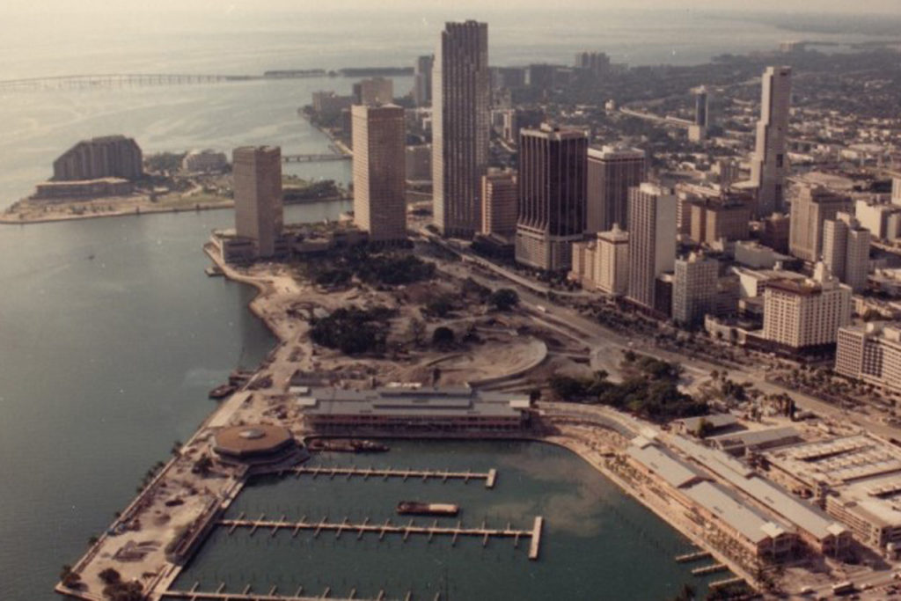
Old Florida
Notes:
Florida is very New.
Least populated southern state in 1940.
Non diversified industry: focused on agriculture, retirees, and tourism/hospitality

Slide 4
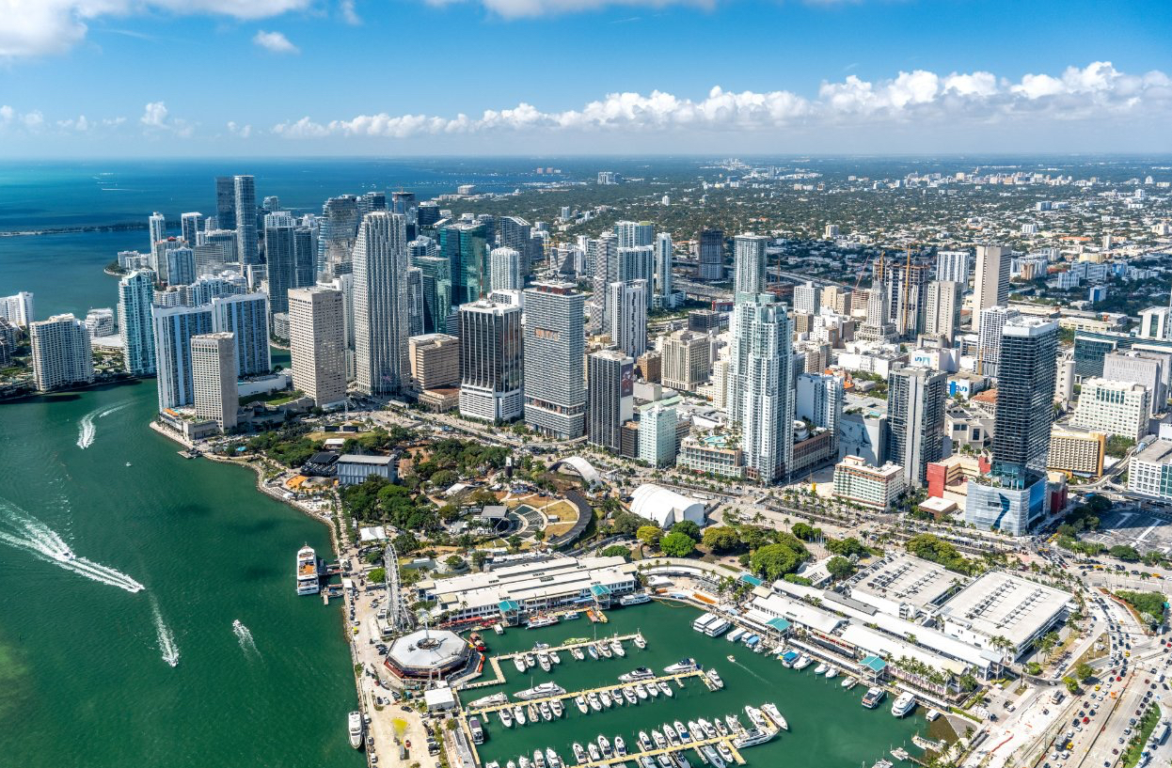
New Florida
Notes:
Fitting that once Florida became popular with the advent and ubiquity of AC in the 1960s around the state, we launched the first manned rocket to space from the CAPE.

Slide 5
Why?
Notes:
2 things: 1) For 30 years Florida has been making smart investments. 2) the world has gone mad and Florida is at the right place/time to take advantage
Its not just what we have done… its what everyone else is doing or failing to do…
Maybe its because it is what happens to every society, market, economy in time. But not in Florida. Since I have lived here, I have only known Florida as GROWTH. Why?

Slide 6
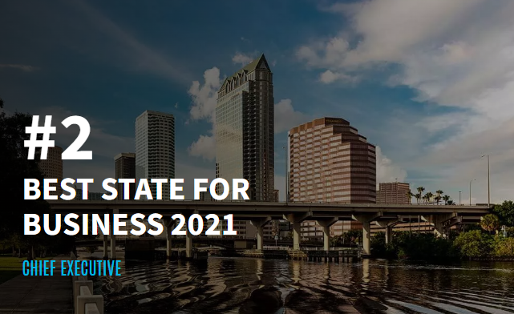
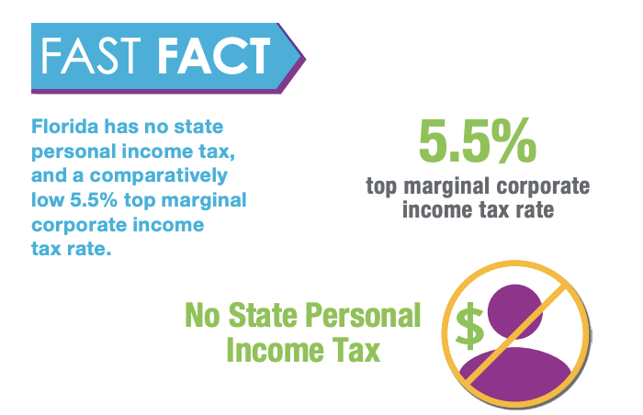
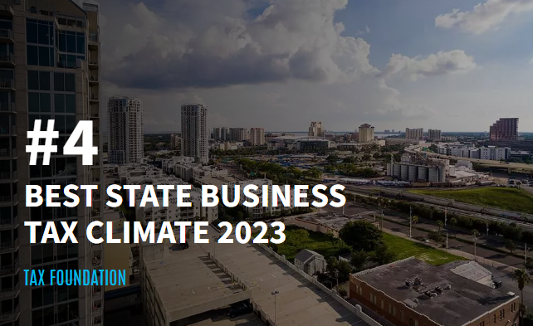
Pro Business Framework
Notes:
We created one of the best business fiscal and regulatory environments in America.
1) Business Friendly Climate
We are looking at bringing in high growth company to Florida for manufacturing. One of their board members moved to Miami over the pandemic and he told us he feels liberated.
Florida is constantly ranked among the most business-friendly states in the United States. Low tax rates, political and monetary stability, regulatory predictability, enforceability of contracts, probusiness policies, and competitive business and living costs make Florida an attractive location for practically any type of business facility.
California, New York, Illinois, rank horribly on regulation and fiscal impact. Meanwhile political instability in our South.
\

Slide 7
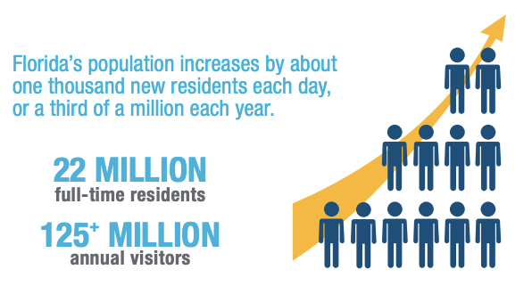
Large Dynamic Market
Notes:
Florida’s trillion-dollar-plus economy is the 4th largest among U.S. states, and among the Top 20 in the world – bigger than those of the Netherlands or Mexico, and about the same size as Spain. Home to about 22 million residents, Florida is now the 3rd most populous U.S. state, with one of the fastest growing economies. This vast, dynamic market offers tremendous business opportunities for international companies across a range of economic sectors.
\

Slide 8
Talent
Notes:
Source: Interactive data from EFI Website; https://www.enterpriseflorida.com/why-florida/workforce/
2) We invested heavily in making our higher education system affordable and world-class. We also have other preeminent, specialized universities.
NYU vs UF.
Florida’s 10.5 million-strong workforce is highly educated, technically skilled, and culturally and linguistically diverse, renowned for its strong work ethic. Globally prominent academic institutions, modern scientific and technical curricula, businessacademia partnerships, and top-rated customized worker training programs make it easy to find the qualified talent needed by almost any kind of business. Florida’s labor costs are highly competitive, especially compared to other top-tier business locations in the United States and most other advanced economies.
Florida average annual manufacturing wages are 20% lower than those in Texas, and 35% lower than California’s.
2.5 million people in the pipeline.
Not to mention how we benefit from all the talent to our south.
Governor DeSantis has also made it a huge priority to focus on technical education
Tech talent and engineering at a number of bootcamps

Slide 9
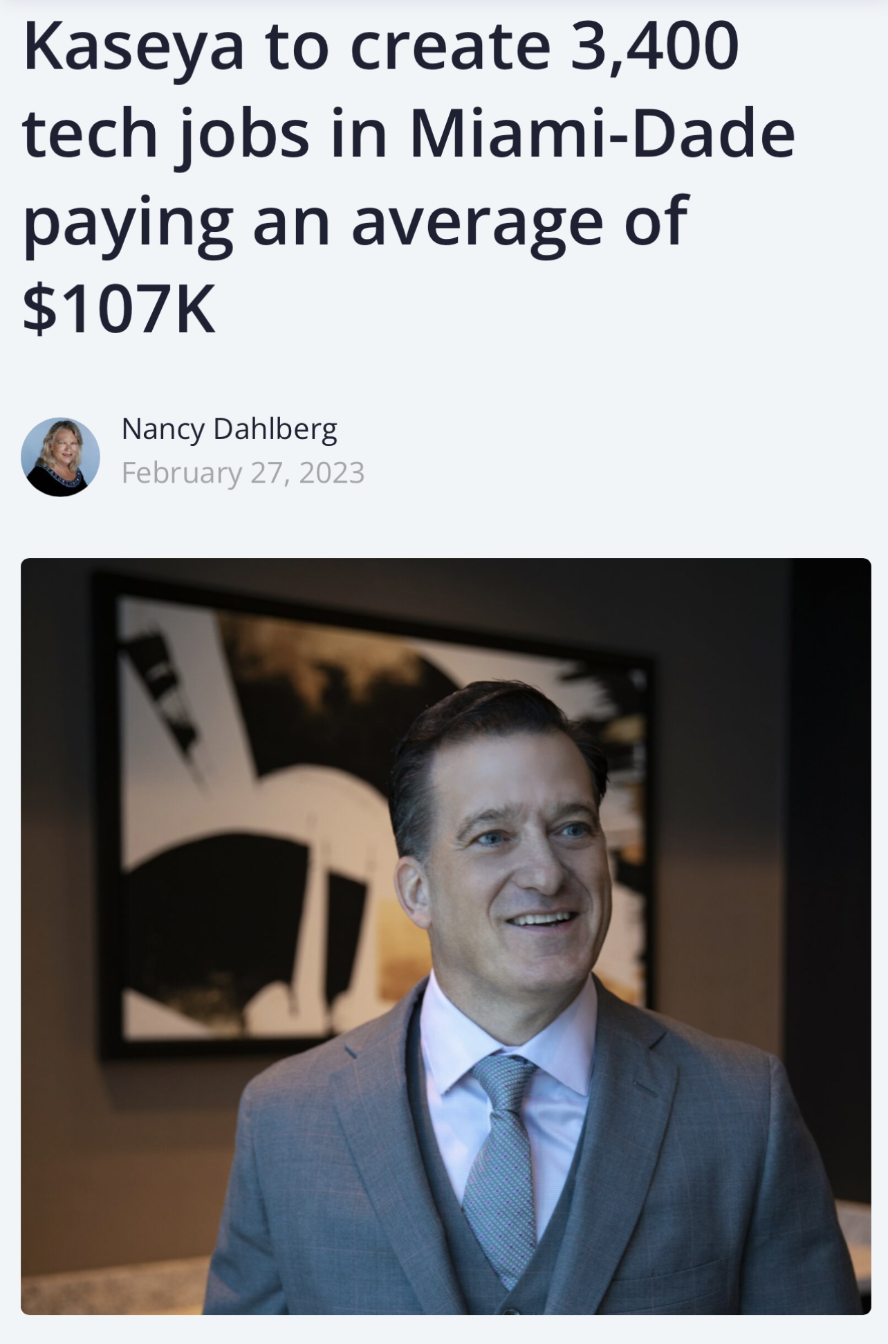
Talent
“The No. 1 reason he cites for being so bullish: the talent.
“If you think about the DNA of Miami, we have a lot of first-generation Americans, a lot of people who fought for the right to be in this country. The work ethic is awesome, the sense of ownership, we have great grit,” said Voccola, a Miami resident who also is an alum of University of Miami. “It’s an awesome labor force.”
He also said the educational systems are focused on preparing students for the real world, not the fabricated world of academia. “It’s very inspiring for us to see that.”
Notes:
Florida’s 10.5 million - strong workforce is highly educated, technically skilled, culturally and linguistically diverse, and renowned for its strong work ethic. Globally prominent academic institutions, modern scientific and technical curricula, business-academia partnerships, and top-rated customized worker training programs make it easy to find the qualified talent needed by almost any kind of business. Florida’s labor costs are highly competitive, especially compared to other top-tier business locations in the United States and most other advanced economies.
2) We invested heavily in making our higher education system affordable and world class. We also have other specialized preeminent universities.
NYU vs UF.
Florida’s 10.5 million-strong workforce is highly educated, technically skilled, and culturally and linguistically diverse, renowned for its strong work ethic. Globally prominent academic institutions, modern scientific and technical curricula, businessacademia partnerships, and top-rated customized worker training programs make it easy to find the qualified talent needed by almost any kind of business. Florida’s labor costs are highly competitive, especially compared to other top-tier business locations in the United States and most other advanced economies.
Florida average annual manufacturing wages are 20% lower than those in Texas, and 35% lower than California’s.
2.5 million people in the pipeline.
Not to mention how we benefit from all the talent to our south.
Governor DeSantis has also made it a huge priority to focus on technical education
Tech talent and engineering at a number of bootcamps

Slide 10
Capacity
Notes:
Florida has made really smart investments in Infrastructure to build capacity.
deeping of the port…
FDOT’s $10B a year work plan… mostly of roads but still
Rail and now with brightline
Airports
Broadband… network accesspoint of America
The Network Access Point in Miami is an example of how Florida connects the world with its innovative data center. This internet exchange point funnels data to South and Central America. As 5G grows and satellites launched from Florida continue to circle Earth, the state is poised to be a leader in the telecommunication sector.
With its state-of-the-art infrastructure, Florida enables the efficient movement of goods, people, and data across the globe. The state’s multimodal transportation system includes 20 commercial airports, 15 deepwater seaports, advanced highway and rail networks, modern fiber-optic telecoms networks, and several major highspeed data transmission hubs. Direct air links enable global passenger and cargo mobility, while numerous shipping routes connect Florida to the world’s leading commercial hubs. Florida is home to one in five U.S. exporters, with the combined annual value of goods and services exports exceeding $100 billion.
\

Slide 11
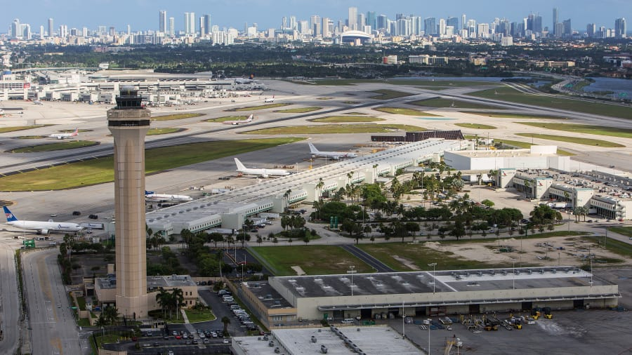
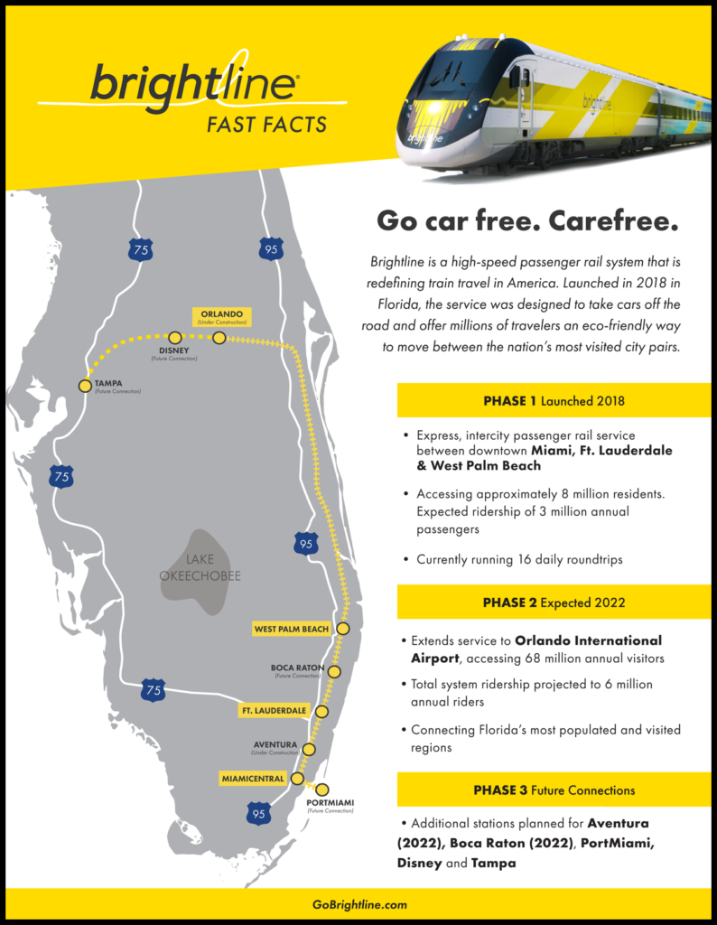
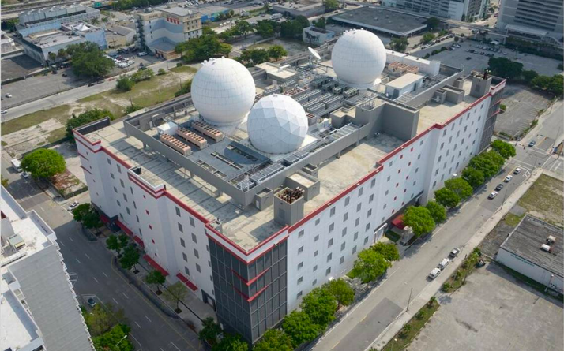
Capacity
Notes:
Florida has made really smart investments in Infrastructure to build capacity.
deeping of the port…
FDOT’s $10B a year work plan… mostly of roads but still
Rail and now with brightline
Airports
Broadband… network accesspoint of America
The Network Access Point in Miami is an example of how Florida connects the world with its innovative data center. This internet exchange point funnels data to South and Central America. As 5G grows and satellites launched from Florida continue to circle Earth, the state is poised to be a leader in the telecommunication sector.
With its state-of-the-art infrastructure, Florida enables the efficient movement of goods, people, and data across the globe. The state’s multimodal transportation system includes 20 commercial airports, 15 deepwater seaports, advanced highway and rail networks, modern fiber-optic telecoms networks, and several major highspeed data transmission hubs. Direct air links enable global passenger and cargo mobility, while numerous shipping routes connect Florida to the world’s leading commercial hubs. Florida is home to one in five U.S. exporters, with the combined annual value of goods and services exports exceeding $100 billion.
\

Slide 12
Florida: Gateway to Latin America & the Caribbean
Notes:
Geography is Destiny!
Florida is host to several thousand affiliates of companies based outside the United States, including hundreds of hemispheric or regional corporate headquarters. Besides corporate HQ’s, many international firms have located other kinds of facilities in Florida, such as manufacturing plants, R&D labs, sales and marketing offices, logistics and distribution operations, and customer service centers, to take advantage of easy access to markets worldwide.
Florida is the Americas’ commercial crossroads. Due to its strategic geographic location, advanced infrastructure, access to finance, and multi-cultural and multi-lingual workforce, Florida serves as the principal gateway to Latin American and Caribbean markets for both U.S. and overseas companies. Florida accounts for about a third of total U.S. trade with Latin America and the Caribbean, and is home to the world’s largest cluster of professional & financial service providers specializing in Latin America.
There are more direct flights from Florida airports to Latin American and Caribbean cities than from the rest of the United States combined. Miami is regularly voted “best Latin American city for business” by CEOs.
As the home to America’s space program and the birthplace of IBM’s personal computer, Florida has a long history of developing and deploying innovative technologies. Nowadays more than 36,000 high-tech business establishments employ about 600,000 Floridians, generating some $12-13 billion in high-tech exports annually. Florida’s biotech firms are behind some of humanity’s greatest health breakthroughs, while its fintech and cyber security professionals are ensuring the smooth, secure conduct of online business. From marine biology to space exploration, propulsion systems to surgical lasers, Floridians are devising cutting-edge solutions for the next economy.
Florida is home to more than 58,000 exporting companies – second only to California. Twenty percent (20%) of the nation’s companies that export are in Florida.
Florida ranks 4th among all U.S. states in high-tech exports – reaching US$13.8 billion in 2021 – and 3rd in the U.S. for the 40.7 thousand direct jobs supported by tech exports in 2018.
One of the most international US states, with global name recognition
A hemispheric hub for business, finance, trade, logistics, travel, and culture
Multicultural & multilingual: 1/5 of Florida’s population (and over half of Miami’s) born outside the United States and speak a foreign language.
One of the highest concentrations of foreign consulates, trade offices, bi-national chambers of commerce, and international banks in the US
Business gateway between Latin America & Caribbean and rest of the world; location for many LatAm regional corporate headquarters, and the US offices of companies based in Latin American countries
Miami regularly voted “best Latin American city for business” by CEOs
As part of the US, Florida enjoys political and economic stability, rules-based legal system, enforceability of contracts, few restrictions on capital flows
Geographic proximity to LatAm, advanced infrastructure, and connectivity
Florida’s diverse, multilingual workforce includes several million native speakers of Spanish, Portuguese, and French – easy to find the right talent
Extensive cultural, linguistic, and family ties to Latin America & Caribbean
Close to 2500 multinational firms, many are regional headquarters for LatAm
The world’s largest cluster of professional & financial service providers specializing in Latin American and Caribbean markets
The largest cluster of international banks in the US outside of New York

Slide 13
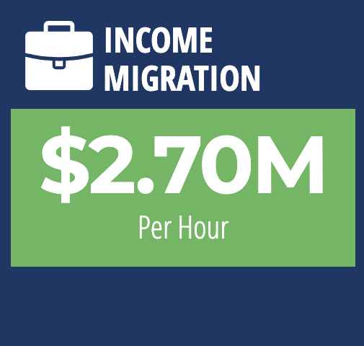
Capital
Notes:
This is newer addition to the list because it is a new phenomenon…
Tax act of 2017
Florida is getting very rich very quickly. Next closest is Texas at $700k every hour net. We are blowing away other states in income and capital attraction. My job is to make sure international brand keeps up with pace of domestic brand. So many people and wealth is moving here, internatonal investors don’t truly understand the scope/impact.
Florida saw a net migration of 20,263 high earning households from 2019 to 2020—four times as much as the next most popular state, Texas.
Kelly Smallridge Wall Street South in Palm Beach
ARK Invest Moves to St. Pete
Always been a financial hub due to South America/Latin America but this is a whole new level
\

Slide 14
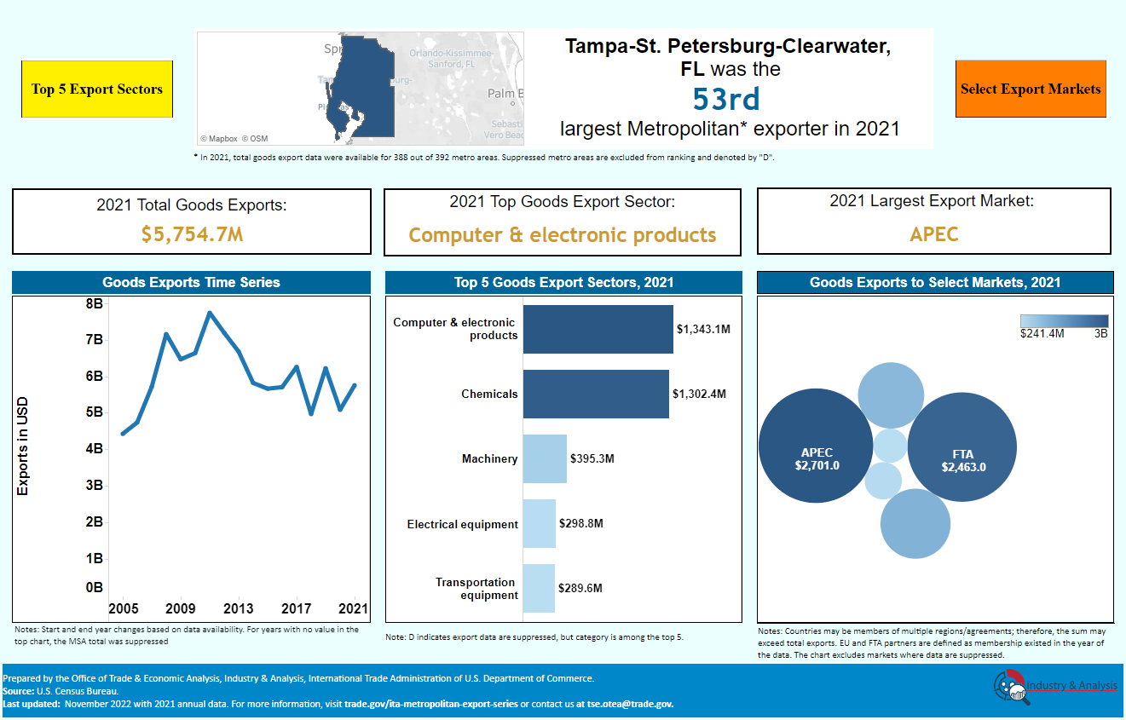
Capital
Notes:
This is newer addition to the list because it is a new phenomenon…
Tax act of 2017
Florida is getting very rich very quickly. Next closest is Texas at $700k every hour net. We are blowing away other states in income and capital attraction. My job is to make sure international brand keeps up with pace of domestic brand. So many people and wealth is moving here, internatonal investors don’t truly understand the scope/impact.
Florida saw a net migration of 20,263 high earning households from 2019 to 2020—four times as much as the next most popular state, Texas.
Kelly Smallridge Wall Street South in Palm Beach
ARK Invest Moves to St. Pete
Always been a financial hub due to South America/Latin America but this is a whole new level
\

Slide 15
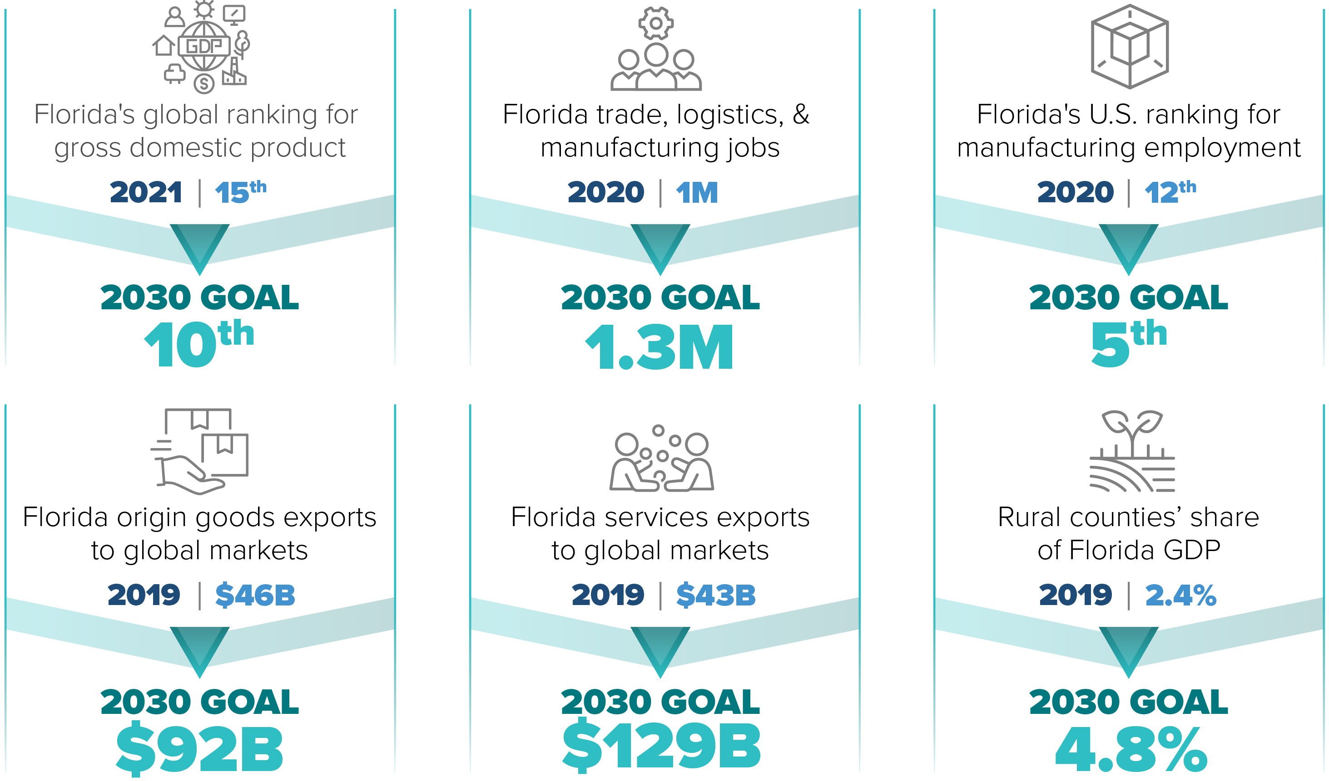
Florida 2030
Notes:
This is newer addition to the list because it is a new phenomenon…
Tax act of 2017
Florida is getting very rich very quickly. Next closest is Texas at $700k every hour net. We are blowing away other states in income and capital attraction. My job is to make sure international brand keeps up with pace of domestic brand. So many people and wealth is moving here, internatonal investors don’t truly understand the scope/impact.
Florida saw a net migration of 20,263 high earning households from 2019 to 2020—four times as much as the next most popular state, Texas.
Kelly Smallridge Wall Street South in Palm Beach
ARK Invest Moves to St. Pete
Always been a financial hub due to South America/Latin America but this is a whole new level
\

Slide 16
Thank you!
@TJVillamil

Slide 17
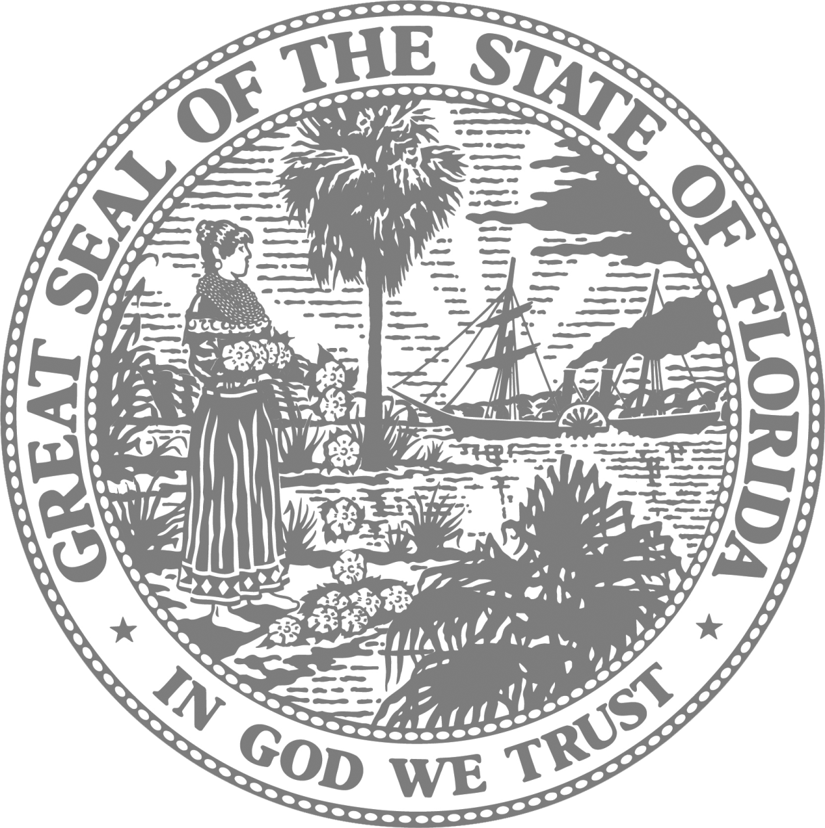
Enterprise Florida Offices
Contact Information
Orlando
800 North Magnolia Avenue, Suite 1100 Orlando, Florida 32803
Tallahassee
101 North Monroe Street, Suite 1000 Tallahassee, Florida 32301
Miami
(International Trade & Development)
201 Alhambra Circle, Suite 610 Coral Gables, Florida 33134
EnterpriseFlorida.com
www.linkedin.com/in/tjvillamil
tjvillamil@enterpriseflorida.com

